Slide 1

Annual Town Meeting
Special Town Meeting
May 16th, 2022 7:00PM
TOWN OF WINCHENDON
Respectfully submitted by Justin B. Sultzbach, Town Manager

Slide 2
STM - Article 1: Committee Report
To see if the Town will vote to hear and act on the reports of the Finance Committee, and any other Board or Committee, or act in relation thereto.

Slide 3
STM - Article 1: Committee Report
DESCRIPTION: This is a usual and customary article to provide Boards and Committees an opportunity to provide reports on various items in town. Boards and Commissions can provide any committee reports they want to share to Town Meeting. Typically, the Finance Committee and Board of Selectmen will use this opportunity if they have information to present.
Submitted by: Town Manager
Board of Selectmen: 0-0-0
Finance Committee: 0-0-0
Vote Required: N/A

Slide 4
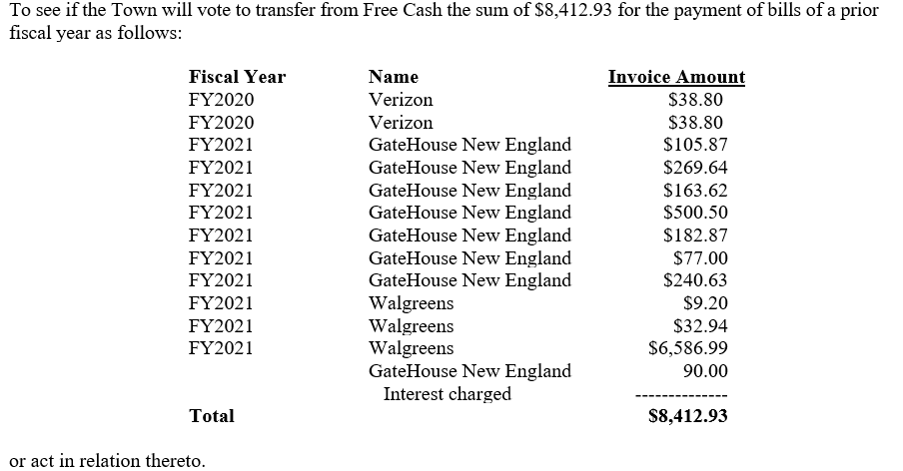
STM - Article 2: Payment of Prior Year Bills

Slide 5
STM - Article 2: Payment of Prior Year Bills
DESCRIPTION : This is a customary article that provides the Town authorization to pay bills remaining from prior fiscal years. We are recommending funding the expenses from Free Cash, and it requires a 9/10ths vote.
Submitted by: Town Manager
Board of Selectmen: 0-0-0
Finance Committee: 0-0-0
Vote Required: 9/10ths Vote

Slide 6
STM - Article 3: Funding of Sewer Enterprise Account Deficit
To see if the town will appropriate from ARPA funds the sum of $35,000 for use by the Board of Selectmen to offset the Sewer Enterprise Fund Budget due to increased chemical and energy costs, or to take any other action related thereto.

Slide 7
STM - Article 3: Funding of Sewer Enterprise Account Deficit
DESCRIPTION : An unforeseen mid-year increase in chemical costs, coupled with a decrease in solar credits for electricity use at the Wastewater Plant, has resulted in a projected $35,000 deficit. We are proposing the use of ARPA funding, rather than Free Cash. Such expenses would typically be covered using retained earnings, however the account is presently depleted. Recent increases to the sewer rate will have us on track to replenish these reserves.
Submitted by: Town Manager
Board of Selectmen: 0-0-0
Finance Committee: 0-0-0
Capital Planning Committee: 0-0-0 In Favor
Vote Required: Majority Vote

Slide 8
ATM - Article 1: Committee Report
To see if the Town will vote to hear and act on the reports of the Finance Committee, or act in relation thereto.

Slide 9
ATM - Article 1: Committee Report
DESCRIPTION : This is a usual and customary article to provide Boards and Committees an opportunity to provide reports on various items in town. Boards and Commissions can provide any committee reports they want to share to Town Meeting. Typically, the Finance Committee and Board of Selectmen will use this opportunity if they have information to present.
Submitted by: Town Manager
Board of Selectmen: 0-0-0
Finance Committee: 0-0-0
Vote Required: N/A

Slide 10
ATM - Article 2: Establish/Discharge Committees
To see if the Town will vote to choose all other Town officers or committees that may be required or deemed necessary to the Town for the ensuing year and give any instructions to same, or to any other town officer or officers, and to discharge any committees which have completed their duties, or act in relation thereto.

Slide 11
ATM - Article 2: Establish/Discharge Committees
DESCRIPTION : Usual and customary article.
Submitted by: Town Manager
Board of Selectmen: 0-0-0
Finance Committee: 0-0-0
Vote Required: Majority Vote

Slide 12
ATM - Article 3: Authorize Revolving Funds
To see if the town will vote to fix the maximum amount to be spent during fiscal year 2023 beginning on July 1, 2022 for the revolving funds established in town by-laws for certain departments, boards, committees, agencies or officers in accordance with Massachusetts General Laws Chapter 44, Section 53 E1/2, or take any other action relative thereto.

Slide 13
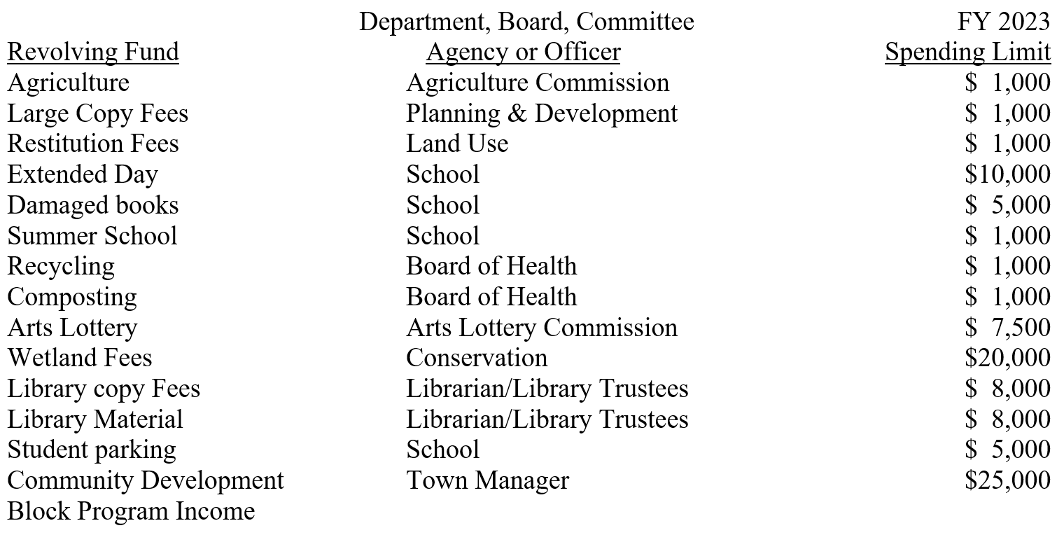
ATM - Article 3: Authorize Revolving Funds
DESCRIPTION :
Submitted by: Town Manager
Board of Selectmen: 0-0-0
Finance Committee: 0-0-0
Vote Required: Majority Vote

Slide 14
ATM - Article 4: Senior Tax Work-Off Program
To see if the Town will vote to raise and appropriate or transfer from other available funds the sum of eight thousand eight hundred dollars ($8,800) for the Senior Tax Work-off Program, or act in relation thereto.

Slide 15
ATM - Article 4: Senior Tax Work-Off Program
DESCRIPTION : This program provides an opportunity for qualified senior members of our community to “work-off” a portion of their Real-estate Tax bill by providing services to the Town throughout the year.
Submitted by: Town Manager
Board of Selectmen: 0-0-0
Finance Committee: 0-0-0
Vote Required: Majority Vote

Slide 16
ATM - Article 5: Community Action Committee Non-Profit Support
To see if the Town will vote to raise and appropriate or transfer from other available funds the sum of $25,000 as a grant to the non-profit, Community Action Committee, Inc., 273 Central Street, Winchendon, in consideration of the numerous services provided to the Town, or act in relation thereto.

Slide 17
ATM - Article 5: Community Action Committee Non-Profit Support
DESCRIPTION : This is a pre-establish annual allotment that is voted at Annual Town Meeting. The $25,000 provides supplemental budgetary assistance to the CAC for services that they provide to economically venerable members of our community.
Submitted by: Town Manager
Board of Selectmen: 0-0-0
Finance Committee: 0-0-0
Vote Required: Majority Vote

Slide 18
ATM - Article 6: FY23 General Government Budget
To see if the Town will vote to raise and appropriate and transfer from other available funds the sum of $16,001,424 for the operating budget of the Town for the fiscal year beginning July 1, 2022, or act in relation thereto.

Slide 19
ATM - Article 6: FY23 General Government Budget
DESCRIPTION : This article appropriates funding for the FY23 General Operating Budget. A line-line by breakdown of how these funds are distributed is available in the Town Meeting Warrant.
Submitted by: Town Manager
Board of Selectmen: 0-0-0
Finance Committee: 0-0-0
Vote Required: Majority Vote

Slide 20
ATM - Article 7: FY23 Water Department Enterprise Budget
To see if the Town will vote to appropriate the sum of $1,111,532 (Water Receipts of $997,942 and ARPA Funds of $113,590) for direct costs of the Water Department Enterprise Fund for the fiscal year beginning July 1, 2022, and that indirect costs of $145,328 appropriated in the general government budget be funded by Water Receipts, or act in relation thereto.

Slide 21
ATM - Article 7: FY23 Water Department Enterprise Budget
DESCRIPTION : This article funds the Water Department Enterprise Budget. Based in part on the recent April 11th, 2022 Board of Selectmen vote to increase rates 10% for FY23 and 8.5% for FY24. This department will run a “planned deficit” in FY23, projected to run at $70,000 based on an independent consultant’s figures. The article is calling for $113,590 based on more conservative estimates from our Accounting office. This not to exceed figure would be funded through ARPA.
Submitted by: Town Manager
Board of Selectmen: 0-0-0
Finance Committee: 0-0-0
Vote Required: Majority Vote

Slide 22
ATM - Article 8: FY23 Wastewater Enterprise Budget
To see if the Town will vote to appropriate the sum of $1,555,315 (Wastewater Receipts of $1,070,018 and Betterment Revenues of $485,297) for the direct costs of the Wastewater Treatment Department Enterprise Fund for the fiscal year beginning July 1, 2022, and that indirect costs of $135,363 appropriated in the general government budget be funded by Wastewater Receipts, or act in relation thereto.

Slide 23
ATM - Article 8: FY23 Wastewater Enterprise Budget
DESCRIPTION : This article funds the Wastewater Department Enterprise Budget. Based in part on the recent April 11th, 2022 Board of Selectmen vote to increase rates 10% for FY23 and 3% for FY24. This department will balance, in part using Betterment Reserves for FY23. We are projecting a modest accumulation of retained earnings for FY23, and will continue to slowly grow this “safety net” until it hits the recommended amount of 5-7.5% of the operating budget.
Submitted by: Town Manager
Board of Selectmen: 0-0-0
Finance Committee: 0-0-0
Vote Required: Majority Vote

Slide 24
ATM - Article 9: FY23 Transfer Station Enterprise Budget
To see if the Town will vote to appropriate the sum of $195,297 from Transfer Station Receipts for direct costs of the Transfer Station Enterprise Fund for the fiscal year beginning July 1, 2022; and that indirect costs of $9,456 appropriated in the general government budget be funded by Transfer Station Receipts, or act in relation thereto.

Slide 25
ATM - Article 9: FY23 Transfer Station Enterprise Budget
DESCRIPTION : This article funds the Transfer Station Enterprise budget, and is projecting to run balanced for FY23.
Submitted by: Town Manager
Board of Selectmen: 0-0-0
Finance Committee: 0-0-0
Vote Required: Majority Vote

Slide 26
ATM - Article 10: FY23 School Budget
To see if the Town will vote to raise and appropriate and/or transfer from available funds the sum of $15,604,992.02 (Required Net School Spending of $18,305,278 plus $365,521 prior year override that includes a 2.5% escalator in increased funding less $3,065,806.98 for net school spending and eligible indirect costs budgeted in the general government budget for School Expenses) for the operating budget of the Winchendon Public Schools for the fiscal year beginning July 1, 2022, or act in relation thereto.

Slide 27
ATM - Article 10: FY23 School Budget
DESCRIPTION : This article provides funding for the Winchendon Public Schools. Funding is based of a net school spending formula provided by the Commonwealth. Total funding includes Ch.70 (State) funds, the Town Contribution, as well as funding from an override passed at previous Town Meetings.
Submitted by: School Committee
Board of Selectmen: 0-0-0
Finance Committee: 0-0-0
Vote Required: Majority Vote

Slide 28
ATM - Article 11: FY23 Monty Tech’s Assessment
To see if the Town will vote to raise and appropriate the sum of $702,108 to fund the Town’s assessment for its share of the Montachusett Regional Vocational Technical School budget for the fiscal year beginning July 1, 2022, or act in relation thereto.

Slide 29
ATM - Article 11: FY23 Monty Tech’s Assessment
DESCRIPTION : This article provides funding for the Town of Winchendon’s allotment for Monty Tech. This is a pre-established formula based figure based in part on enrollment from Winchendon students.
Submitted by: Town Manager
Board of Selectmen: 0-0-0
Finance Committee: 0-0-0
Vote Required: Majority Vote

Slide 30
ATM - Article 12: Capital Improvements – Free Cash
To see if the Town will vote to transfer from Free Cash the sum of $650,847 and that the Town be authorized to accept any available grant funds, for the purposes of funding the following capital requests, or take any other action relative thereto.

Slide 31
ATM - Article 12: Capital Improvements – Free Cash
DESCRIPTION : This portion of the proposed FY23 Capital Improvement Plan (provided below) is recommended to be funded through the use of Free Cash. While the property at 70 Pleasant Street (Children’s Library) has been removed, the proposed funding has been shifted to the Phase 2 Library Repairs in an effort to cover escalating construction costs due to material and labor shortages.
Department | Description | Amount
Town Manager | Town Hall Cupola Repairs | $35,000
DPW | Road Paving (Supplemental) | $129,823
Library | Phase 2 Repairs Additional | $314,500
Police | Radio Project Match | $154,649
Police | Livescan Fingerprint Scanner | $16,875
Submitted by: Capital Planning Committee
Board of Selectmen: 0-0-0
Finance Committee: 0-0-0
Capital Planning Committee: 5-0-0 *vote taken prior to changes to library funding
Vote Required: Majority Vote

Slide 32
ATM - Article 13: Capital Improvements – 5 Year Borrowing
To see if the Town will vote to raise and appropriate, transfer from available funds, and/or borrow the sum of $969,220 for the purposes of funding the following capital requests, or take any other action relative thereto.

Slide 33
ATM - Article 13: Capital Improvements – 5 Year Borrowing
DESCRIPTION : This portion of the proposed FY23 Capital Improvement Plan (provided below) is recommended to be funded through the use of a 5 year borrowing, and would require a 2/3rds vote. A decrease should be note ($60,000) in the Pumper Truck Replacement request.
Department | Description | Total Amount | Annual Payment
DPW | DPW Roofs | $315,000 | $63,000
DPW | Excavator and Trailer | $160,125 | $32,025
Fire Department | Pumper Truck Replacement | $494,095 | $102,772
Submitted by: Capital Planning Committee
Board of Selectmen: 0-0-0
Finance Committee: 0-0-0
Capital Planning Committee: 5-0-0
Vote Required: 2/3rds Vote

Slide 34
ATM - Article 14: Capital Improvements – Transfer Station
To see if the Town will vote to raise and appropriate, transfer from available funds, and/or borrow the sum of $54,697 for the purposes of funding the following capital requests, or take any other action relative thereto.

Slide 35
ATM - Article 14: Capital Improvements – Transfer Station
DESCRIPTION : This portion of the proposed FY23 Capital Improvement Plan (provided below) is recommended to be funded through the use of retained earnings from the Transfer Station Enterprise Fund. A 2/3rds vote is required.
Department | Description | Amount
DPW | Transfer Station Vehicle | $54,697
Submitted by: Capital Planning Committee
Board of Selectmen: 0-0-0
Finance Committee: 0-0-0
Capital Planning Committee: 5-0-0
Vote Required: Majority Vote

Slide 36
ATM - Article 15: Capital Improvements – Grants/Other Sources
To see if the Town will vote to appropriate the sum of $544,968 and that the Town be authorized to accept any available grant funds, for the purposes of funding the following capital requests, or take any other action relative thereto.

Slide 37
ATM - Article 15: Capital Improvements – Grants/Other Sources
DESCRIPTION : This portion of the proposed FY23 Capital Improvement Plan (provided below) is recommended to be funded through the use grants or other sources – particularly ARPA funding.
Department | Description | Total Amount | Grant Source
DPW | Front End Loader | $146,000 | ARPA
DPW | Wheeled Excavator | $205,216 | ARPA
DPW | Trailed Vactor | $98,834 | ARPA
Police | Cruiser Replacement | $54,918 | 911 Grant
Planning | Project Design Funding | $40,000 | ARPA
Submitted by: Capital Planning Committee
Board of Selectmen: 0-0-0
Finance Committee: 0-0-0
Capital Planning Committee: 5-0-0
Vote Required: Majority Vote

Slide 38
ATM - Article 16: Ambulance Payment
To see if the Town will vote to transfer from Free Cash the sum of $60,405 for the purposes of paying the last year of debt service for the 2016 Ambulance; or act in relation thereto.

Slide 39
ATM - Article 16: Ambulance Payment
DESCRIPTION : We are proposing the utilization of Free Cash to pay down the last instalment of the 2016 Ambulance one year early. This will provide $60,000 in relief on the debt service line of the FY23 Annual Operating budget, allowing us to balance for FY23.
Submitted by: Town Manager
Board of Selectmen: 0-0-0
Finance Committee: 0-0-0
Vote Required: Majority Vote

Slide 40
ATM - Article 17: Town Charter Amendment
To see if the Town will vote pursuant to G.L. c.43B, §10(a) to amend the Town Charter as recommended by the Charter Bylaw Review Committee as shown below with text to be inserted underlined and text to be deleted crossed out;

Slide 41
ATM - Article 17: Town Charter Amendment
DESCRIPTION : This article, proposed by the Charter Bylaw Review Committee, provides clarification for the appointment of members to some boards or committees. This change would require a 2/3rds vote.
Submitted by: Charter Bylaw Review Committee
Board of Selectmen: 0-0-0
Finance Committee: 0-0-0
Vote Required: 2/3rds Vote

Slide 42
ATM - Article 18: General Bylaw Amendment
To see if the Town will vote to amend the General Bylaws of the Town of Winchendon as recommended by the Charter Bylaw Review Committee as shown below with text to be inserted underlined and text to be deleted crossed out:
Bylaws: Page 6
SECTION 2.9: CAPITAL PLANNING COMMITTEE
(May 20, 2013)
Appointments. Consistent with the Winchendon Home Rule Charter, Section 2.3(d), the Committee shall be composed of five registered voters of the Town - one to be appointed by the moderator and one to be appointed by each of the following: Board of Selectmen, School Committee, Finance Committee and Planning Board. There shall be a five (5) member Capital Planning Committee comprised of one (1) member of the Board of Selectmen (appointed by the Board of Selectmen), one (1) member of the School Committee (Appointed by the School Committee), one (1) member of the Finance Committee (appointed by the Finance Committee), one (1) member of the Planning Board (appointed by the Planning Board), and one (1) member who is a registered voter of the Town but not on any of the above Committees or Boards, to be appointed by the Town Moderator. The Committee shall choose a chairman. Appointments shall be made following the Annual Town Meeting, for the period beginning July 1 through June 30 of each year. Vacancies shall be filled in the manner of the original appointment for the remainder of the unexpired term; provided, however that if 30 days pass after notice of the vacancy has been provided to the respective appointing authority, the committee may fill the position under Section 7-8 of the Town Charter. Each appointing authority shall consider the qualifications of applicants for appointment, and who will best be able to represent both Town employees and taxpayers. If possible, appointees shall include registered voters who are familiar with and experienced with financial principles.
1/3

Slide 43
ATM - Article 18: General Bylaw Amendment
Bylaws: Page 100
ARTICLE 38
TOWN OF WINCHENDON GROUP INSURANCE AND BENEFIT COMMITTEE
(ATM May 18, 2015)
There shall be a Group Insurance and Benefit Committee in the Town of Winchendon comprised of one
  member of the Board of Selectmen (appointed by the Board of Selectmen), one (1) member of the Finance Committee (appointed by the Finance Committee), one (1) member of the School Committee (appointed by the School Committee) and two (2) registered voters in the town who have group insurance and benefit experience, preferably municipal (appointed by a majority vote of the three Board and Committee member appointees).
Administrative support staff to the Group Insurance and Benefit Committee shall be provided by the Town Manager, the Town Accountant, the Town Treasurer-Collector, the Superintendent of Schools and the School Business Manager.
The Group Insurance and Benefit Committee shall annually, on or before December 31st, review the Town’s group insurance and benefit plan offerings and shall make written recommendations to the Town Manager relative to the following:
Group Health Insurance Programs
Group Dental Insurance Programs
Group Life Insurance Programs
Optional Life Insurance Programs
Optional Disability Insurance Programs
Deferred Compensation Programs; and
OBRA Defined Contribution Plan for part-time, temporary and seasonal employees who are not eligible to join the retirement plans
One member of the Group Insurance and Benefit Committee, selected by the Committee, shall serve as a non-voting member on and liaison to the Town’s Insurance Advisory Committee (IAC).
2/3

Slide 44
ATM - Article 18: General Bylaw Amendment
Bylaws: Page 54
ARTICLE 24
RECREATION COMMISSION (5.21.18)
(A) There shall be a Recreation Commission [the Commission] consisting of seven (7)
nine (9) members appointed by the Board of Selectmen as follows:
Seven (7) adult members who reside in Winchendon
Two (2) full time middle or high school students who are in good standing and who reside in Winchendon. A student may not hold an adult seat.
One (1) member shall be a Winchendon middle school student in good standing, and one (1) member shall be a Winchendon high school student in good standing.
  The terms shall be Each adult member shall serve for three years and so arranged that the term of as nearly an equal number as is possible shall expire each year.
  Upon the completion of these original terms, Each member shall serve for three years.
  Student members shall be appointed annually.
  No more than two members of the same household shall hold concurrent seats.
2. The Commission acts in an advisory capacity in matters pertaining to public recreation, makes annual budget recommendations and assists in planning a recreation program to stimulate public interest.
3. The stated primary function of the Commission is to expand and enhance the recreation opportunities for the residents of Winchendon.
or act in relation thereto.
3/3

Slide 45
ATM - Article 18: General Bylaw Amendment
DESCRIPTION : This article, proposed by the Charter Bylaw Review Committee, proposes three clarifications.
Eligibility for appointment to the Capital Planning Committee to prevent potential double representation from one committee or another.
Disbands the “Town of Winchendon Group Insurance Benefit Committee”. This committee was added in May 2015. While well-intentioned, it has not met in the seven years since it’s creation.
Alters the amount of available seats on the Recreation Commission and clarifies language regarding eligibility for appointment.
Submitted by: Charter Bylaw Review Committee
Board of Selectmen: 0-0-0
Finance Committee: 0-0-0
Vote Required: Majority Vote

Slide 46
ATM - Article 19: Zoning Bylaw Amendment
To see if the Town will vote to amend Chapter 9 of the Zoning Bylaws of the Town of Winchendon, entitled “Signs,” by deleting the current Chapter 9 and inserting in its place a new chapter regulating the use of signs in Winchendon, as recommended by the Planning Board in a document entitled “2022 Proposed Zoning Bylaw Revisions” on file in the office of the Town Clerk and available on the Town’s website at http://www.townofwinchendon.com.

Slide 47
ATM - Article 19: Zoning Bylaw Amendment
DESCRIPTION : Chapter 9 of our Zoning Bylaws regarding signage was identified earlier in the year as being outdated, unclear, and at times needlessly restrictive.
In an effort to make a more comprehensive, reasonable, and business friendly document, the Planning Board has spent the last months going through an exhaustive public review process. This helped craft a more complete document, and ultimately included input from members of the general public. Where this involves zoning changes, a 2/3rds vote would be required.
Submitted by: Planning Board
Board of Selectmen: 0-0-0
Finance Committee: 0-0-0
Planning Board : 5-0-1
Vote Required: 2/3rds Vote

Slide 48
ATM - Article 20: Authorization – Drinking Water and Sewer Asset Management Project
To see if the Town will vote to appropriate the sum of $125,000 for the Winchendon Drinking Water and Sewer Asset Management Project which is on the Massachusetts 2022 Clean Water State Revolving Fund Asset Management Planning Project List. The total project cost of $125,000 is comprised of a $75,000 grant (60% of the total project cost) which the Town will be reimbursed for in two payments of approximately $37,500 each at 50% and 100% project completion by MassDEP and the Massachusetts Clean Water Trust. The balance of the project will be comprised of in-kind services provided by the Town valued at $25,000 and a cash contribution from Water and Sewer Enterprise Funds valued at $25,000; and to take any other action relative thereto.

Slide 49
ATM - Article 20: Authorization – Drinking Water and Sewer Asset Management Project
DESCRIPTION : This is language provided by Mass DEP as a requirement for a $75,000 grant to provide consulting services for a Water and Sewer Asset Management project. This will help us better catalogue our existing assets, and will help support our plan to regularly repair and maintain our Water/Sewer infrastructure over the next ten year period. As described in the language of the article, a Town Meeting Vote is required to commit to $25,000 in in-kind contributions (Staff support) and $25,000 in other funds. We are proposing the use are ARPA funds as the Town Match.
Submitted by: Town Manager
Board of Selectmen: 0-0-0
Finance Committee: 0-0-0
Vote Required: Majority Vote

Slide 50
ATM - Article 21: Transfer of Webster Street Parcel 5A3-0-185 to Winchendon Redevelopment Authority
To see if the Town will vote to authorize the Board of Selectmen to convey the Town-owned property on Webster Street as shown on Assessors Map 5A3 Parcel 0-185 to the Winchendon Redevelopment Authority, for such consideration, and upon such other terms and conditions as the Board deems appropriate, and to take such additional action as may be needed to effectuate the purposes of this vote, including but not limited to execution of instruments and documents to convey said property, or act in relation thereto.

Slide 51
ATM - Article 21: Transfer of Webster Street Parcel 5A3-0-185 to Winchendon Redevelopment Authority
DESCRIPTION : The Webster Street Parcel, highlighted on the next slide in yellow, is located behind the existing Walgreens off Central St. We are proposing to transfer the Town-Owned parcel to the Winchendon Redevelopment Authority for future development opportunities. The site has some mild contamination from past industrial use and is partially restricted, but could still be used for passive recreation such as a more formalized extension of the existing bike path. Because this involves the transfer of land, a 2/3rds vote is required.
Submitted by: Town Manager
Board of Selectmen: 0-0-0
Finance Committee: 0-0-0
Vote Required: 2/3rds Vote

Slide 52
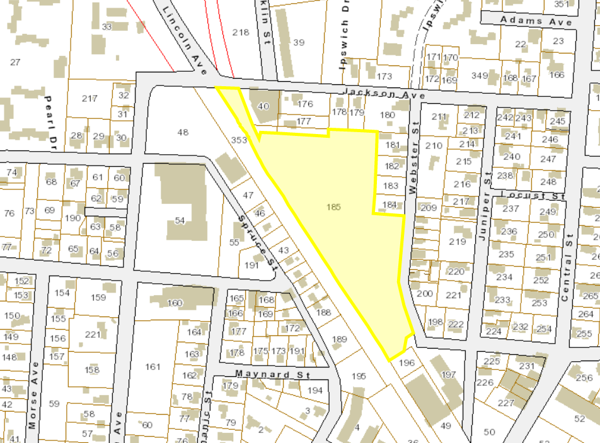
ATM - Article 21: Transfer of Webster Street Parcel 5A3-0-185 to Winchendon Redevelopment Authority
Submitted by: Town Manager
Board of Selectmen: 0-0-0
Finance Committee: 0-0-0
Vote Required: 2/3rds Vote

Slide 53
Thank you for attending this Annual Town Meeting
May 16th, 2022
TOWN OF WINCHENDON

