Slide 1
Town of Winchendon
FY 2023 Water and Sewer Rate Study Update
April 7, 2022

Slide 2
Who is
Raftelis?
Our staff includes
130+
consultants focused on finance/management/ communication/technology for the public sector
5 20
The largest utility financial and management consulting practice in the nation.
AWWA and WEF utility finance and management committees and subcommittees
&
chairs
members of
&
the Immediate Past President of AWWA
+
former utility leaders & subject matter experts in key fields like communications & data analytics

Slide 3
Rate Study
Overview

Slide 4
Rate Study Process
STEP 5: ASSESS EFFECTIVENESS IN ADDRESSING PRICING OBJECTIVES
STEP 4: DESIGN RATE STRUCTURE STEP 3: ALLOCATE COSTS
STEP 2: IDENTIFY REVENUE REQUIREMENTS & DEMAND PROJECTIONS
STEP 1: IDENTIFY FINANCIAL & PRICING OBJECTIVES
5
4
3
2
1

Slide 5
Revenue Requirements & Financial Planning
FINANCIAL PLAN ELEMENTS
CAPITAL PROJECT FUNDING
FINANCIAL PLAN INPUTS
Customer accounts
Billed consumption
Revenues
Operating expenses
Capital plan
Beginning cash position
Funding Mix
(Cash vs. Debt)
Debt
Covenants
ANNUAL REVENUE REQUIREMENTS
ANNUAL CASH FLOW
FISCAL POLICIES AND TARGETS
Cash
Reserves
Debt Service
Coverage

Slide 6
Financial Plans
& Required Rate Increases

Slide 7
Analyzed Financial Planning Scenarios
Water
No rate increases over the forecast period (not viable)
Upfront 18% increase in FY23, with 3% increases from FY24-27
10% increase in FY23, 8.5% increase in FY24, and 3% increases from FY25-27
Sewer
No rate increases over the forecast period, FY23-27 (not viable)
Upfront 10% increase in FY23, with 3% increases from FY24-27

Slide 8
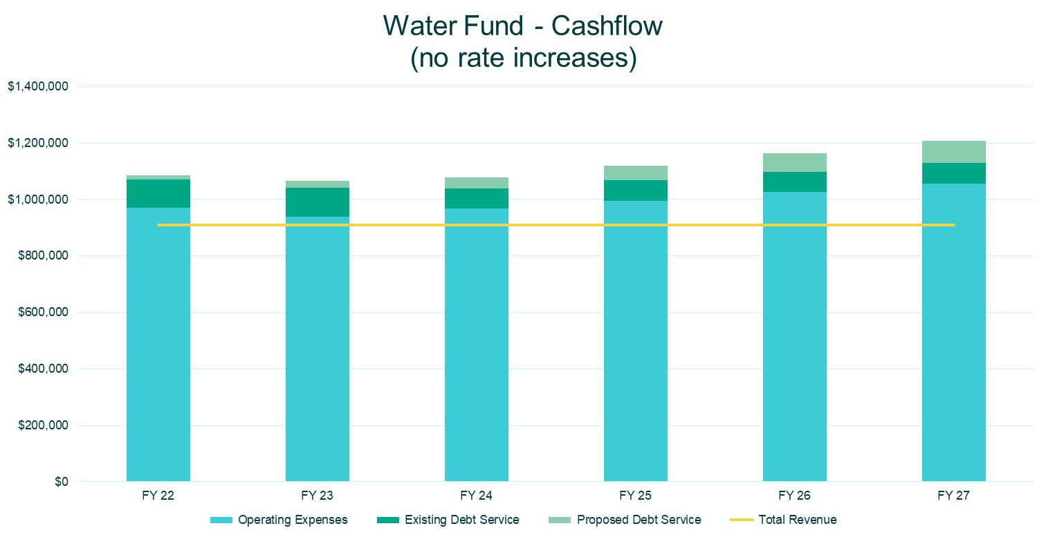

Slide 9
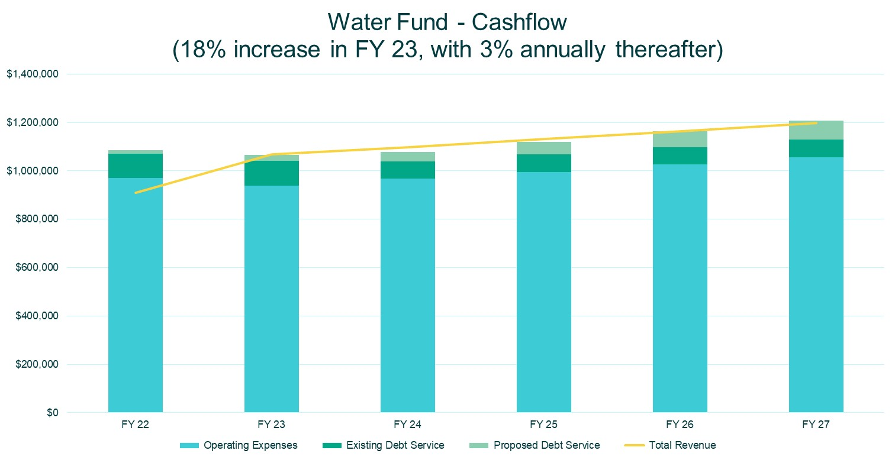

Slide 11
Note: Existing debt service in FY23 is be refinanced. A small surplus is forecasted in FY 23

Slide 12
Note: Existing debt service in FY23 is be refinanced. A small surplus is forecasted in FY 23

Slide 13
Customer Impacts

Slide 14
Note: Both FY23 Options assume a 10% increase in Sewer Rates

Slide 15
Wastewater Treatment Plant Operations – Cost/Benefit Analysis
There is little cost difference between contract and in-house operations
Contracting operations mitigates the Town’s risk exposure and limits potential unexpected costs
The hiring market for operations staff within the industry is dismal
Quality candidates are few and far between and are demanding significantly higher salaries than prior market norms
At this time, it is recommended to continue contract operations

Slide 16
Raftelis is a Registered Municipal Advisor within the meaning as defined in Section 15B (e) of the Securities Exchange Act of 1934 and the rules and regulations promulgated thereunder (Municipal Advisor Rule). However, except in circumstances where Raftelis expressly agrees otherwise in writing, Raftelis is not acting as a Municipal Advisor, and the opinions or views contained herein are not intended to be, and do not constitute “advice” within the meaning of the Municipal Advisor Rule.

Slide 17
Thank you!
Contact: Dave Fox
774 243 0619 / dfox@raftelis.com

