Slide 1
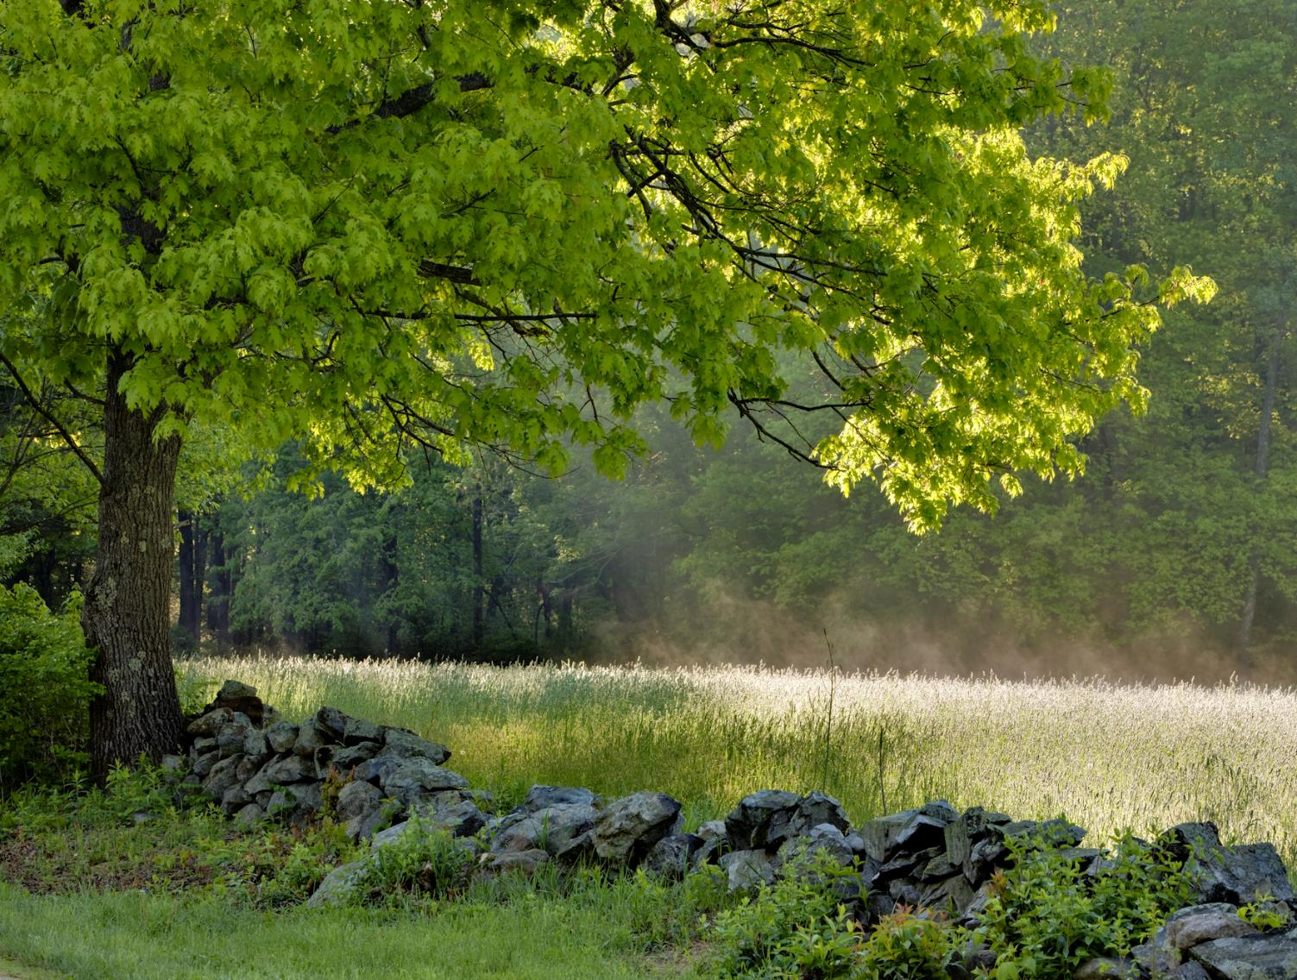
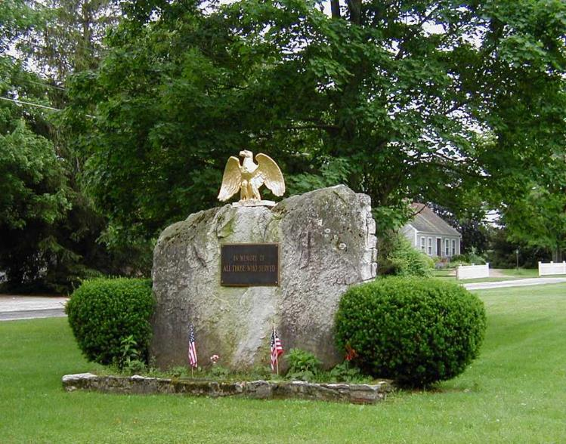
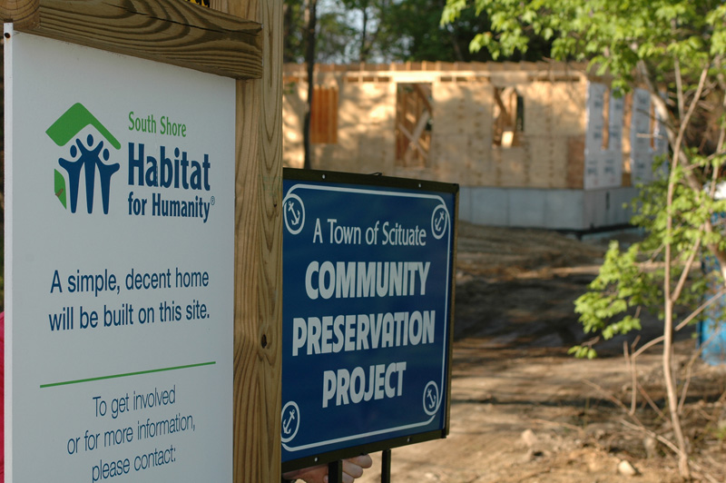
Introducing the Community
Preservation Act (CPA)
Notes:
ALL PHOTOS ARE LABELED IN THE FOLLOWING ORDER: STARTING WITH THE TOP LEFT AND GOING CLOCKWISE.

Slide 2
The Community Preservation Coalition
Representatives from 8 member communities and 7 at-large members

Slide 3
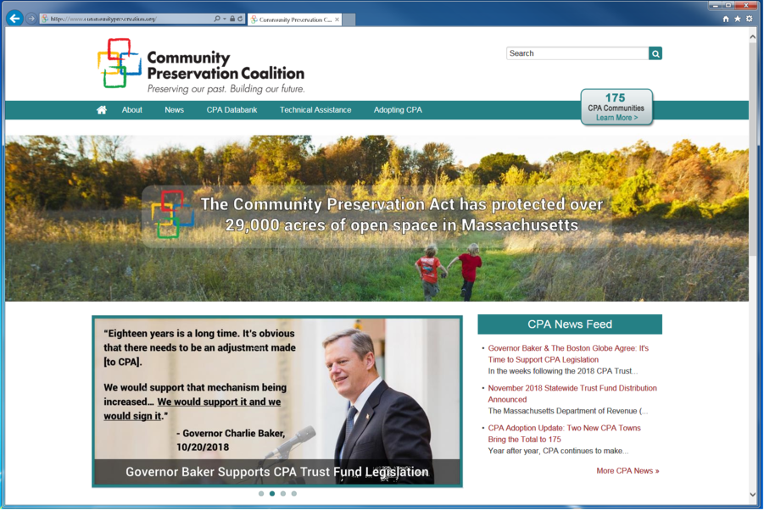
The Coalition Website www.communitypreservation.org

Slide 4
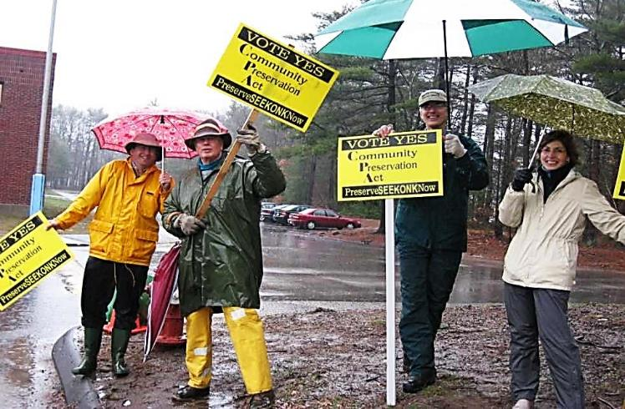
What is the Community Preservation Act (CPA)?
The Community Preservation Act is state enabling legislation passed in 2000
Must be adopted by individual communities at a local ballot election
Notes:
- Former Governor Cellucci signing CPA into law in 2000
- Seekonk CPA campaigners

Slide 5
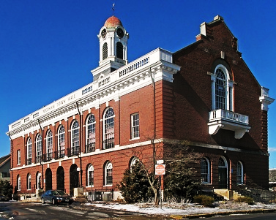
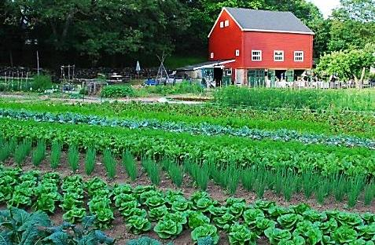
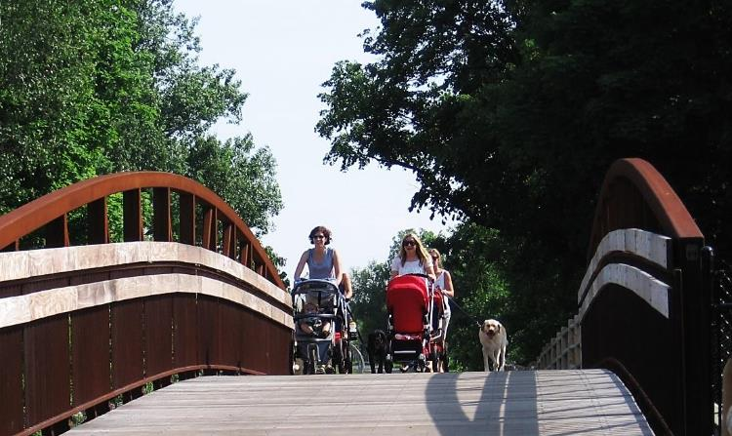
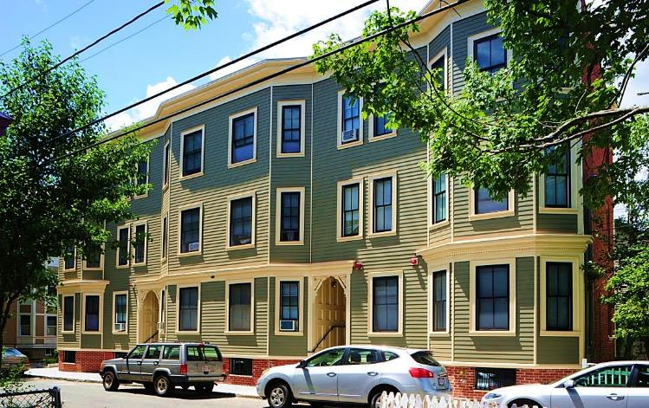
Basics of CPA
Enables communities to establish a local restricted fund for:
Historic Preservation
Open Space & Recreation
Community Housing
Notes:
Clockwise From Top Left
Needham Town Hall
Newton Angino Farm
Newburyport Rail Trail
Cambridge Affordable Housing

Slide 6
Over Half the State Has Adopted CPA!
Total of 187 Cities and Towns
53% of municipalities
65% of Massachusetts residents
0 communities have revoked
Notes:
6

Slide 7
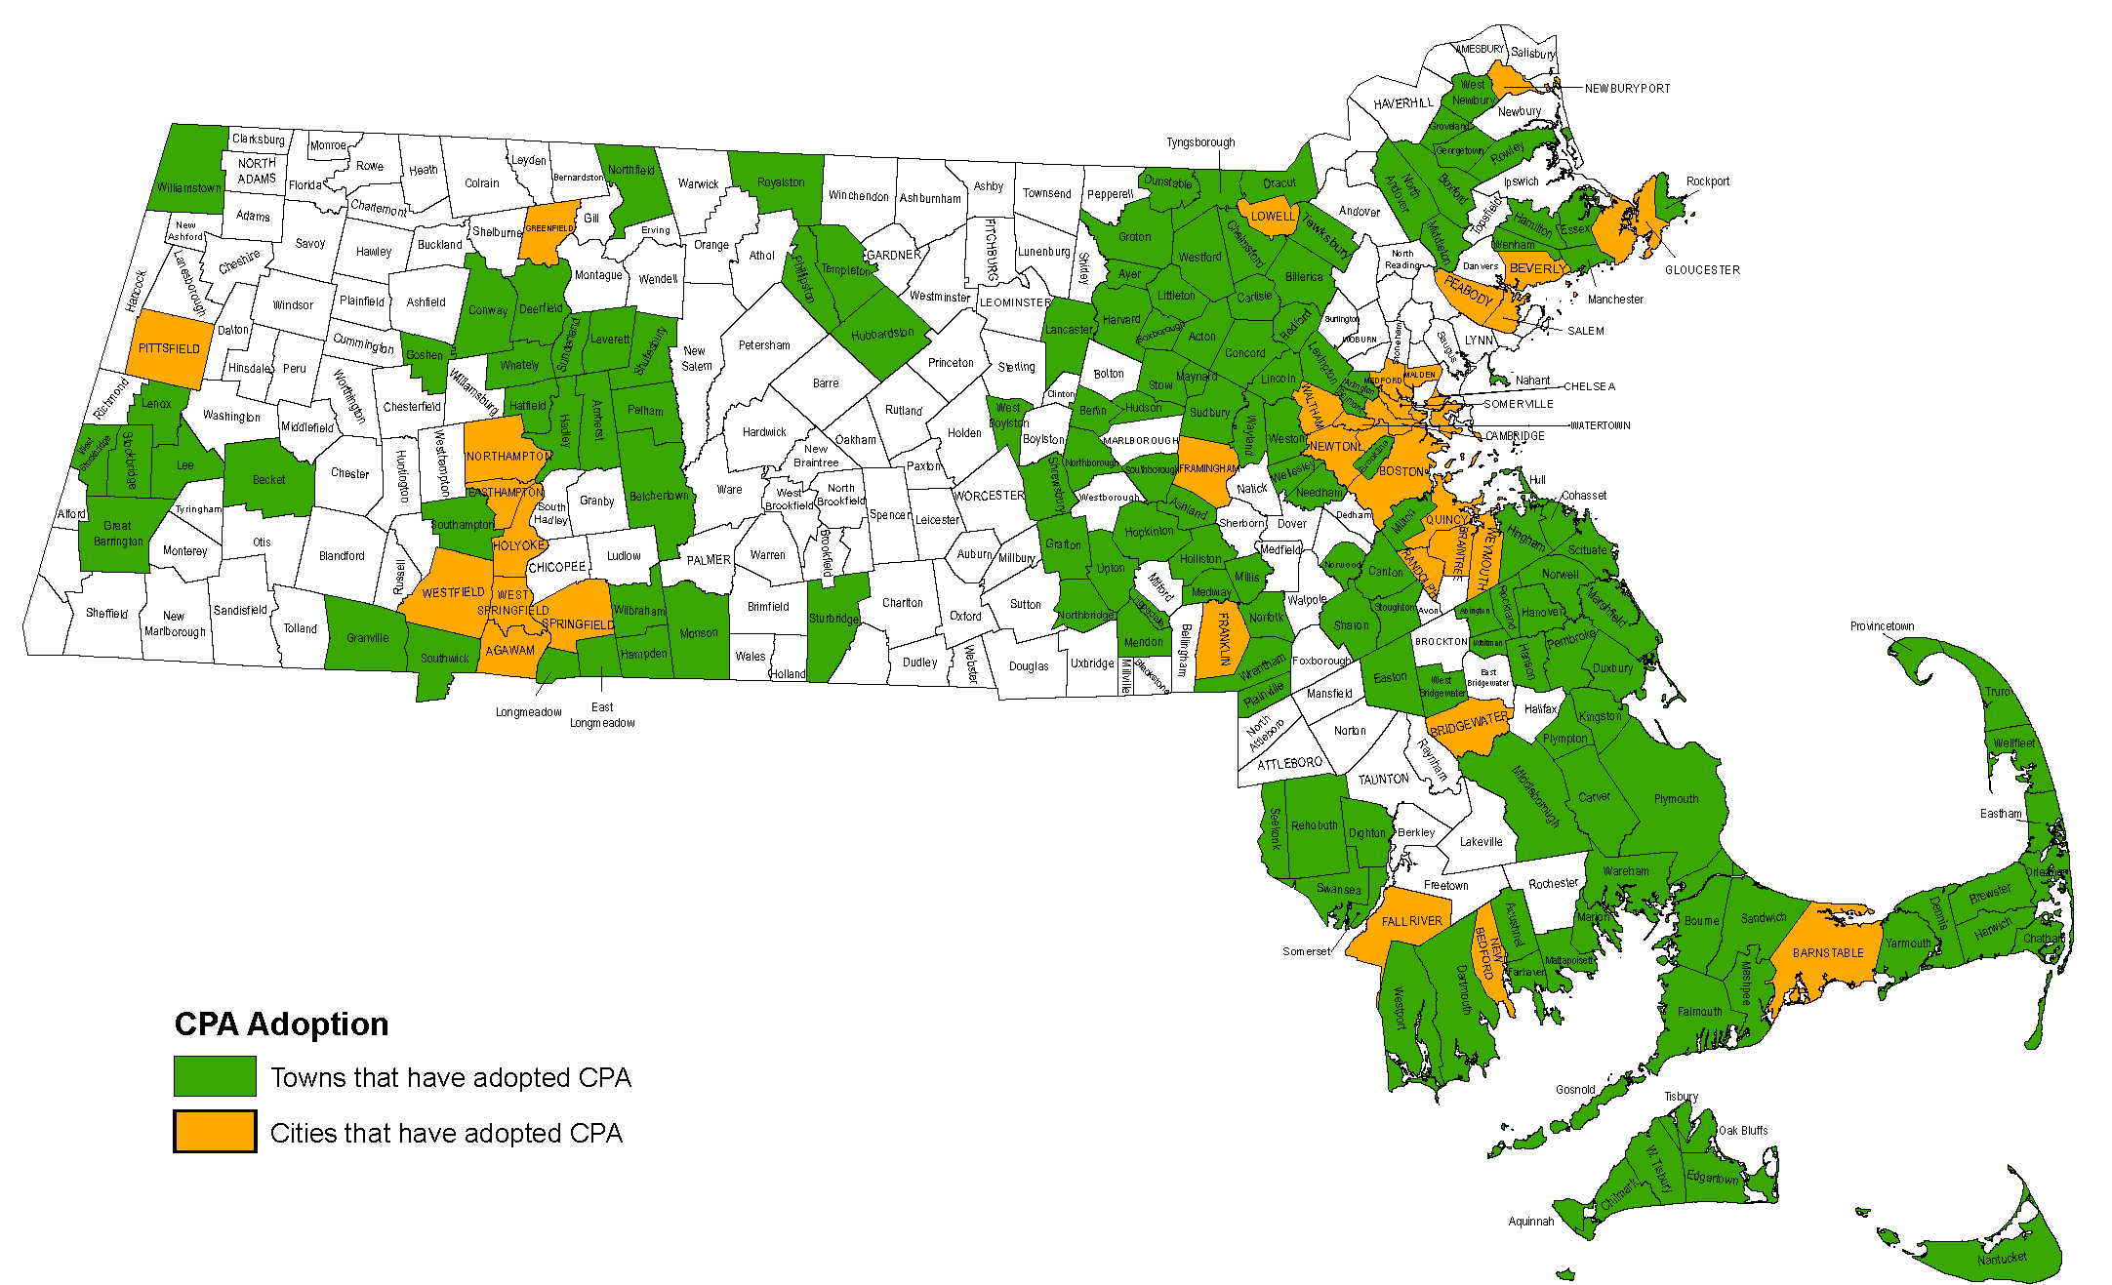
187 CPA Communities
Notes:
7

Slide 8
CPA by the Numbers
(through end of FY2021)
- Over 14,000 projects approved & $2.65 billion raised -
HISTORIC PRESERVATION: 6,300 appropriations made
OPEN SPACE: 32,566 acres preserved
OUTDOOR RECREATION: 3,000 projects funded
AFFORDABLE HOUSING: 8,700 housing units created

Slide 9
Basics of CPA – CPA Revenue Sources
Local Surcharge:
Up to 3% surcharge on local
property tax bills
State Contribution:
Annual distribution from statewide CPA Trust Fund
Community decides surcharge level and which exemptions to adopt

Slide 10
Surcharge Levels – Anything Up to 3%
3%
Largest number of communities, but not many recently
1.5%
Highest Success Ratio
~$50
The “sweet spot” for an average annual taxpayer cost

Slide 11

Menu of CPA Exemptions
❑
❑
First $100,000 of residential property value
First $100,000 of commercial & industrial property value
Low income families; low/moderate income seniors
Full commercial and industrial exemption (with split tax rate only)
❑
❑
❑
*Note: Any existing property tax exemptions apply to the CPA surcharge

Slide 12
Example: what would a homeowner pay
with a 1% CPA surcharge?
Assessed Home Value $416,644
With $100,000 exemption -$100,000
Net House Value Surcharged $316,644
Municipal Tax Rate (per $1000) x $15.38 ________
Amount Subject to Surcharge $4869 CPA Surcharge Rate x 1%
________
Amount paid toward CPA Fund $49
This homeowner would pay $49 into the municipality’s
Community Preservation fund annually.

Slide 13
The Statewide CPA Trust Fund
Guaranteed annual disbursement each November
Administered by the Department of Revenue (DOR)
Funds come from fees charged on documents filed at the Registries of Deeds ($50 and $25 as of December 31st, 2019)
November 2021 base match was 39.4% of what communities raised at the local level – a new record-high distribution of $79 million to CPA communities

Slide 14
How To Adopt – Two Paths to the Ballot
Step One:
Put CPA Question on the Ballot
Legislative Body Vote
OR
Collect signatures of 5% of registered voters

Slide 15
How To Adopt – The Election Ballot
Step Two:
Vote on CPA on the next regularly scheduled municipal or state election

Slide 16
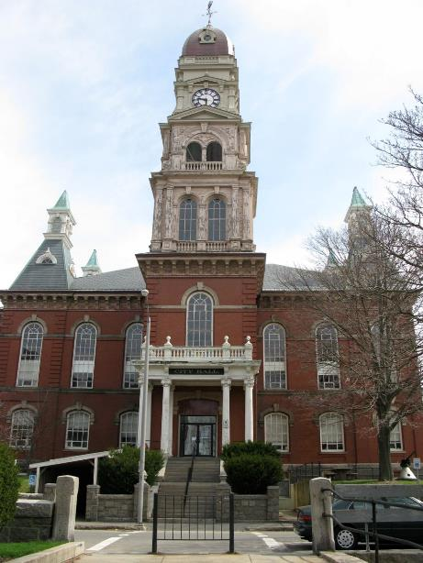
How Does CPA Work?
Each CPA municipality passes a Community Preservation Committee Bylaw/Ordinance
5 Statutory Members
Conservation Commission
Planning Board
Housing Authority
Parks and Recreation
Historic Commission
Up to 4 At-Large Members

Slide 17
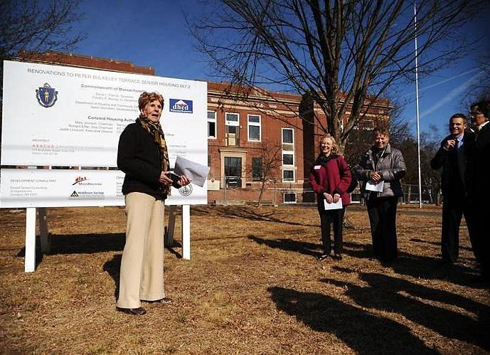
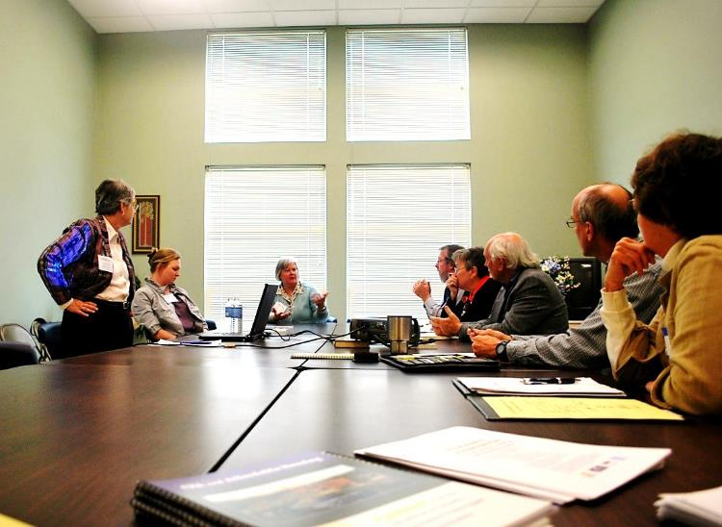
Role of the Community Preservation Committee
Assess community’s CPA needs
Accept/review project proposals
Get input from the public and boards/committees
Recommend CPA projects to Town Meeting/City Council
NOTE: Legislative Body approval required for all CPA projects!

Slide 18
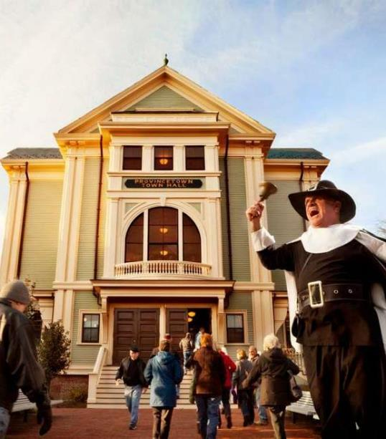
How do CPA Projects Happen?
Project proponents submit applications to Community Preservation Committee (CPC)
CPC reviews projects, gets input
CPC recommends list of projects to Legislative Body
Majority vote of Legislative Body required for each project to get CPA $$$
Notes:
Provincetown Town Hall Celebration following complete rehabilitation with CPA funds

Slide 19
Rules for Annual CPA Spending

Slide 20
What is Eligible for CPA Funds?
CPA Allowable Uses Chart
 | Open Space | Historic | Recreation | Housing
Acquire | YES | YES | YES | YES
Create | YES | NO | YES | YES
Preserve | YES | YES | YES | YES
Support | NO | NO | NO | YES
Rehabilitate and/or Restore | NO (unless acquired or created with CPA $$) | YES | YES | NO (unless acquired or created with CPA $$)

Slide 21
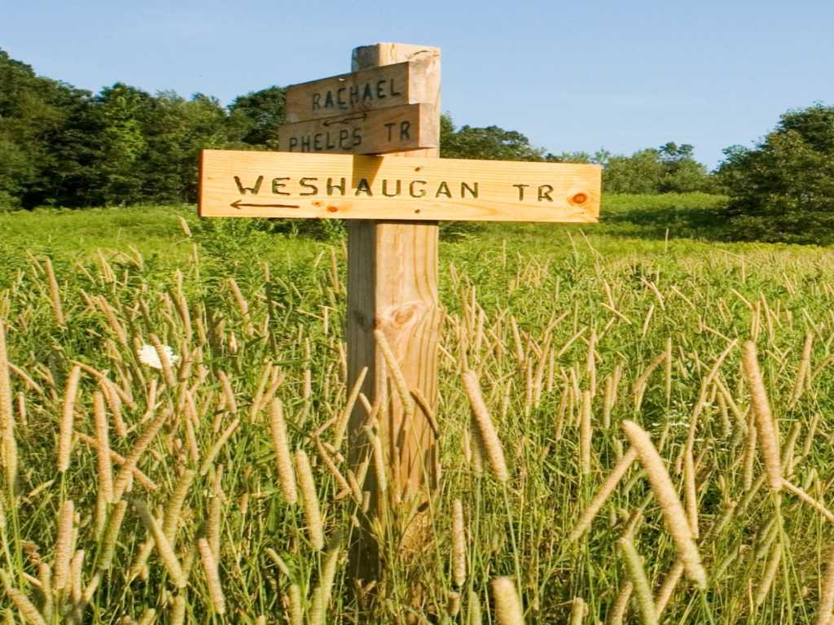
Amending or Repealing the CPA
After adoption, CPA must remain in place for at least 5 years
After 5 years, the Act can be repealed at any time
Amendments to the CPA surcharge percentage or the exemptions can be made at any time
Notes:
Wilbraham open space preservation project

Slide 22
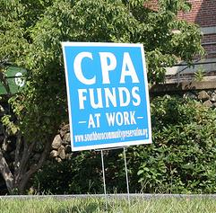
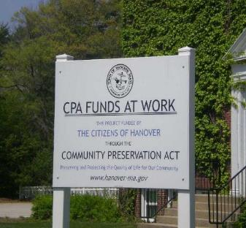
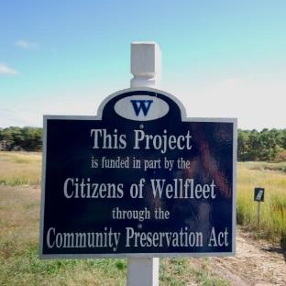
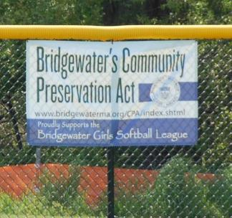
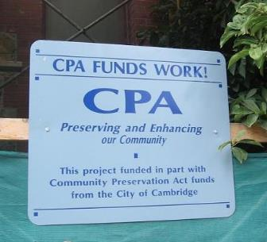
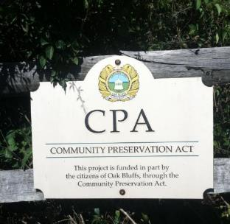
CPA Funds at Work!

Slide 23
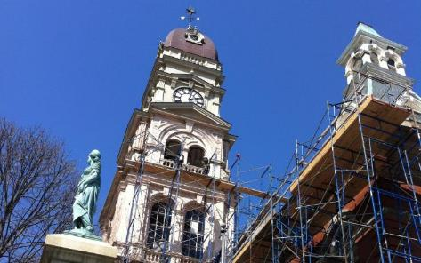
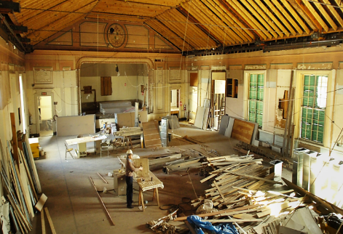
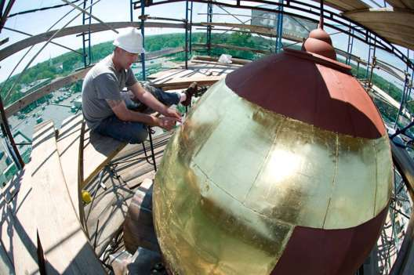
CPA and Historic Preservation
Restoration of historic
municipal buildings
Notes:
Gloucester town Hall
Randolph Stetson Memorial Hall
Sandwich Town Hall

Slide 24
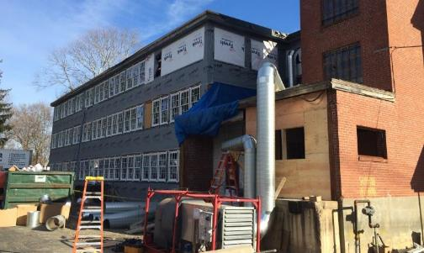
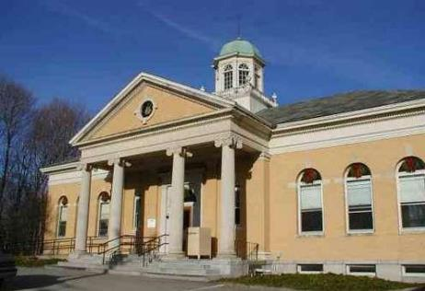
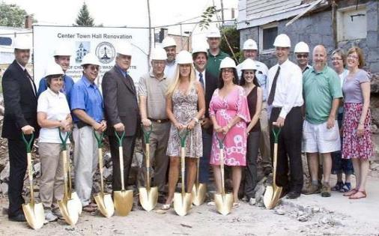
CPA and Historic Preservation
Adaptive Reuse of Historic Buildings
Notes:
Lexington Historic Print Shop turned into housing for Brain-injured adults
Chelmsford Town Hall turned into a Community Arts center
Cohasset Library turned into Affordable Housing for seniors

Slide 25
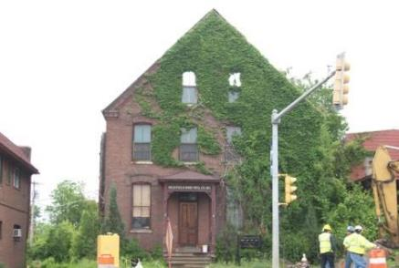
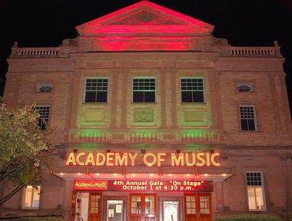
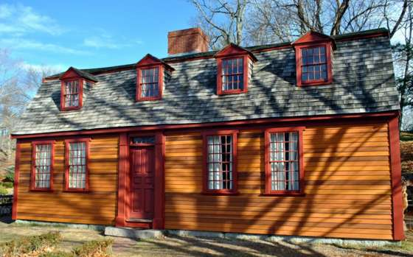
CPA and Historic Preservation
Grants to non-profit community groups (typically with a preservation easement)
Notes:
- Concord historic rehabilitation of theatre for the arts

Slide 26
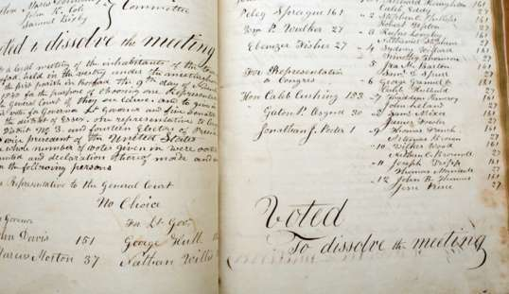
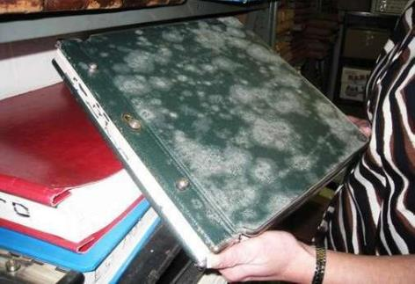
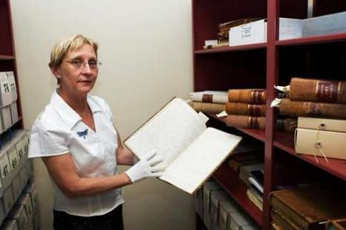
CPA and Historic Preservation
Historic Municipal
Document Preservation
Notes:
Boxford Town Records
“ “ “
- Mendon Town Records pre preservation/restoration

Slide 27
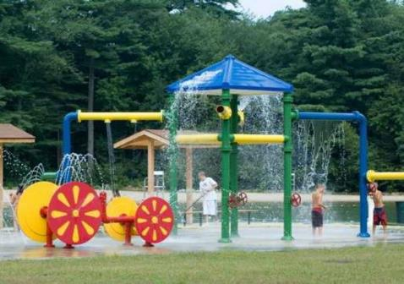
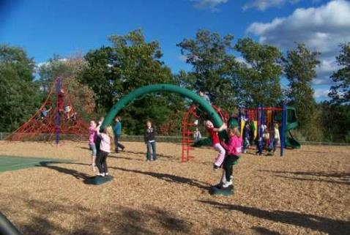
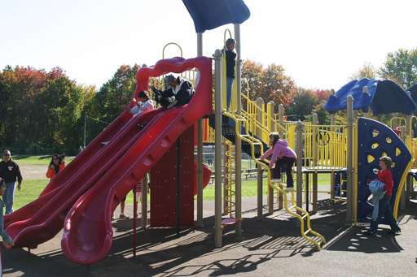
CPA and Open Space/Recreation
Playgrounds
Notes:
Bedford splash park
Agawam playground
Belchertown playground

Slide 28
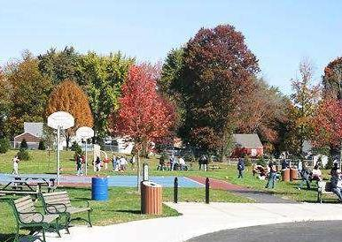
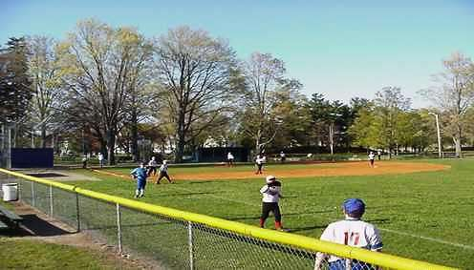
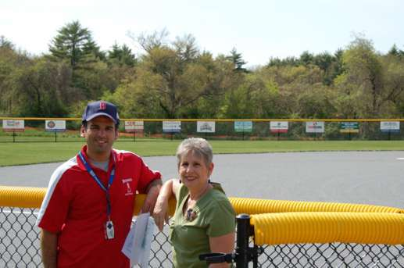
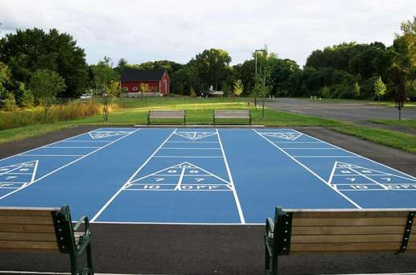
CPA and Open Space/Recreation
Athletic Fields
Notes:
Agawam athletic fields
Bridgewater new girls’ softball fields with Rec. Director and CPC Chair
Sudbury playing fields

Slide 29
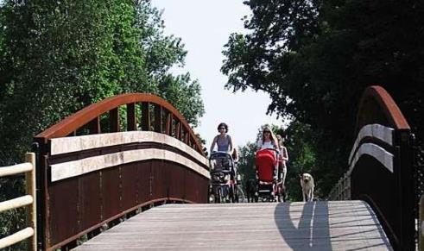
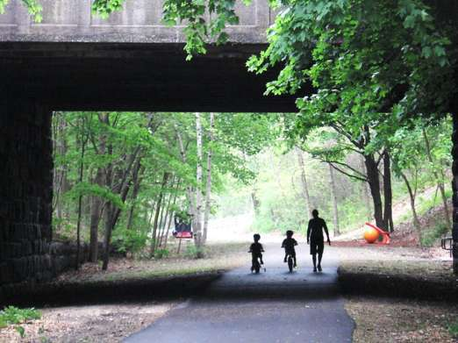
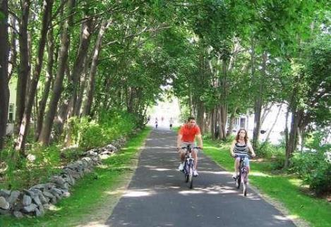
CPA and Open Space/Recreation
Off Road Biking Trails
Notes:
Newburyport Clipper town Rail Trail
“ “ “
“ “ “

Slide 30
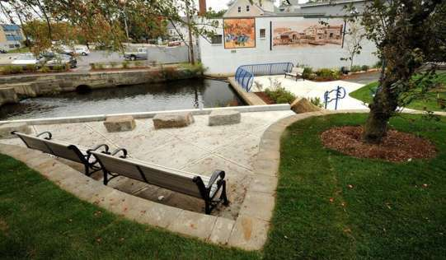
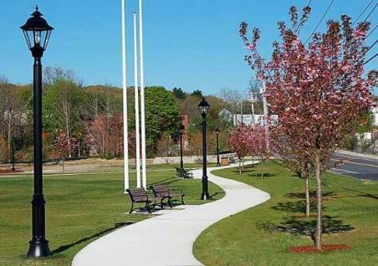
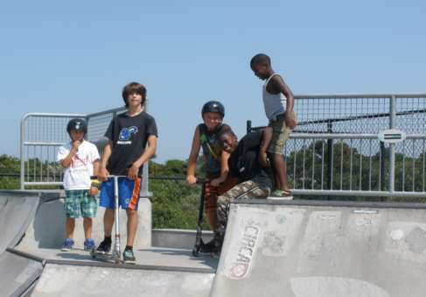
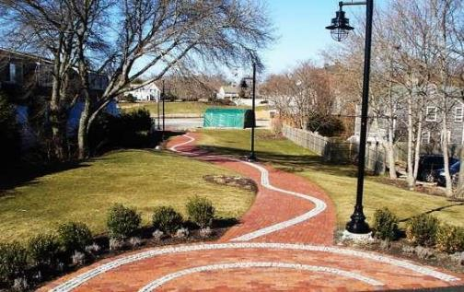
CPA and Open Space/Recreation
Parks
Notes:
Weymouth Herring Run park
Barnstable pocket park
Nantucket skateboard park

Slide 31
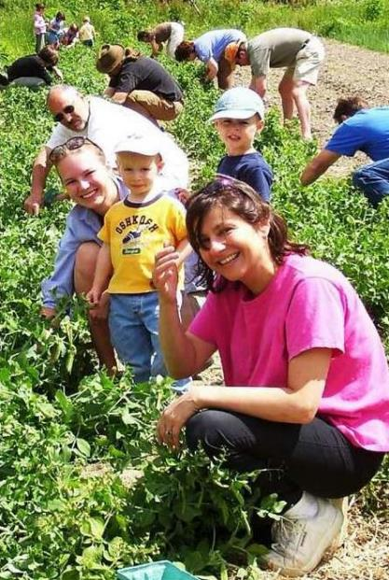
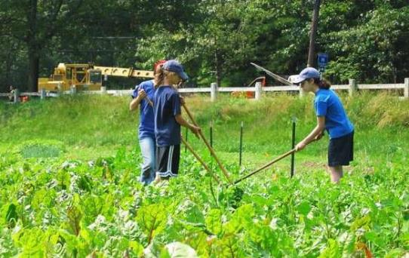
CPA and Open Space/Recreation
Community Gardens
Notes:
Williamstown farm
Newton Angino farm

Slide 32
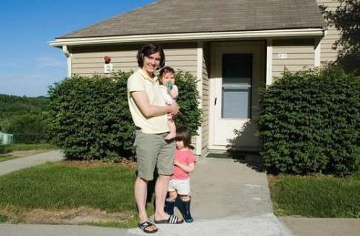
CPA and Affordable Housing
For families & individuals earning up to 100% of areawide median income
Notes:
Stow Pilot Grove affordable housing
Cambridge affordable housing

Slide 33
CPA and Affordable Housing
Housing for Veterans
Notes:
- Dartmouth housing for veterans
- Hingham housing for veterans
- Quincy housing for veterans

Slide 34
CPA and Affordable Housing
Adaptive Reuse of Existing Buildings
Notes:
Historic Shovel Shop in Easton BEFORE
Historic Shovel Shop in Easton AFTER turned into affordable housing
Cohasset Library turned into affordable housing for seniors

Slide 35
CPA and Affordable Housing
Meeting Specialized Community Needs
Notes:
- Douglas House (historic print shop turned into housing for brain-injured adults) in Lexington (ALL PHOTOS)

Slide 36
CPA and Affordable Housing
Community Involvement
and Non-profit Partnerships
Notes:
Housing built by Habitat for Humanity in Martha’s Vineyard,
Housing built by Habitat for Humanity in Scituate
Construction crew from local technical school in Lincoln working on CPA-funded affordable home

Slide 37
Questions?
For more information: www.communitypreservation.org
617-367-8998
Notes:
Town of Plympton – Election Day – Tractor with vote for CPA sign

