Slide 1
Winchendon, MA
Cultivation and Manufacturing Facility

Slide 2
Community Outreach Meeting Objectives
The type of Marijuana Establishment to be located at the proposed address;
Information adequate to demonstrate that the location will be maintained securely;
Steps to be taken by the Marijuana Establishment to prevent diversion to minors;
A plan by the Marijuana Establishment to positively impact the community; and
Information adequate to demonstrate that the location will not constitute a nuisance as defined by law.

Slide 3
The Company

Slide 4
Executive Summary
Our Disabled Veteran-Led Company brings expertise and a unique background in business management, law enforcement, cultivation, and operational excellence. As a licensed Marijuana Cultivation and Manufacturing facility, we will bring the Massachusetts marijuana community a variety of marijuana products and services.
The extensive experience of our management team along with our previous experience in business operations will be the foundation on which we continue to build.
CNA Stores looks forward to becoming an integral part of the Winchendon community and shall offer a safe and secure environment.

Slide 5
CNA Stores Inc.
MISSION STATEMENT
At CNA Stores our mission is to cultivate Quality, Integrity, and Commitment. We produce the highest quality product that provides an unparalleled experience and promotes a better quality of life. We have the Integrity to do the right thing even when no one is watching and are Committed to our Veterans, our Community, and the Environment.

Slide 6
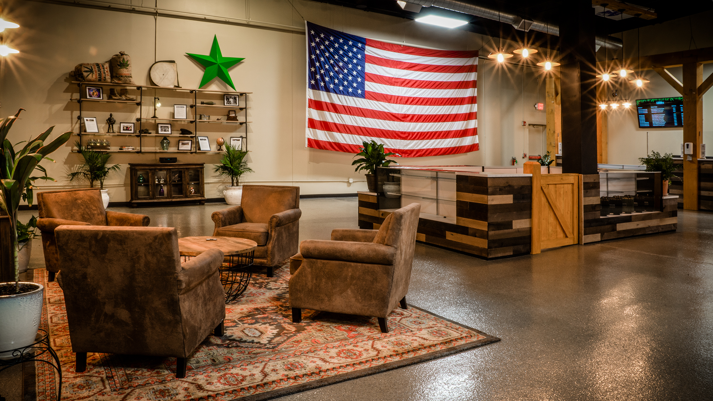
CNA Stores Overview
RETAIL LOCATIONS
Haverhill, MA
558 River St., Haverhill, MA
Approximately 9,000 sq. ft.
Open and operational.
Amesbury, MA
77 Macy St., Amesbury, MA
Approximately 5,500 sq. ft
Open and operational.
Boston, MA
South Boston
Approximately 2,000 sq. ft
Site Control and obtained a Host Community Agreement with the City of Boston.
Currently filing for our license with the Cannabis Control Commission
CULTIVATION AND MANUFACTURING
Amesbury, MA
57 South Hunt Rd, Amesbury MA
Approximately 53,000 sq.ft.
We currently have our provisional licenses for cultivation and Manufacturing
We have received our special permit and Building permit from the City of Amesbury.
Approximately 40,000 Sq.ft of Canopy and a 20,000 sq.ft of Manufacturing and office space
Expected opening October 2022

Slide 7
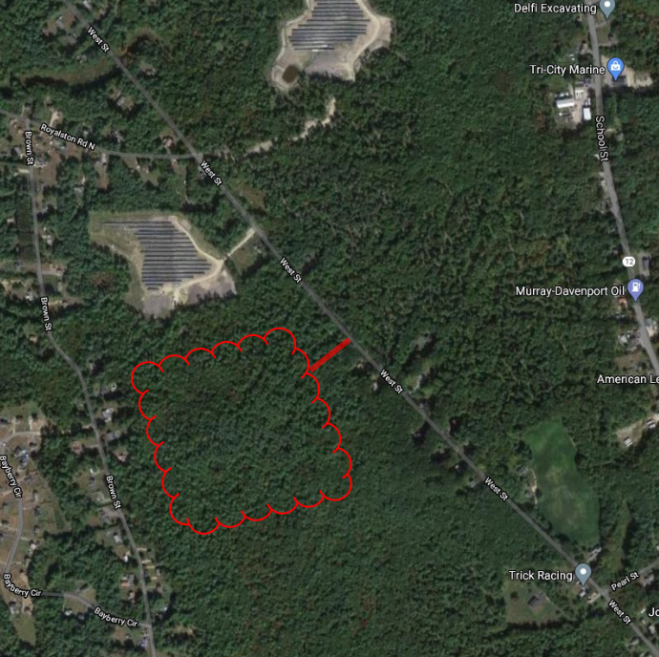
CNA Stores Vision for our Winchendon, MA Facility
CULTIVATION AND MANUFACTURING SITE
Currently we have site control over 14 acres in Winchendon, MA
Cultivate and Manufacture marijuana products.
Employ as many Veterans and personal from Winchendon as possible.
Vertical Farming Approach
Sustainable operations
Oder Controls
Phased approach

Slide 8
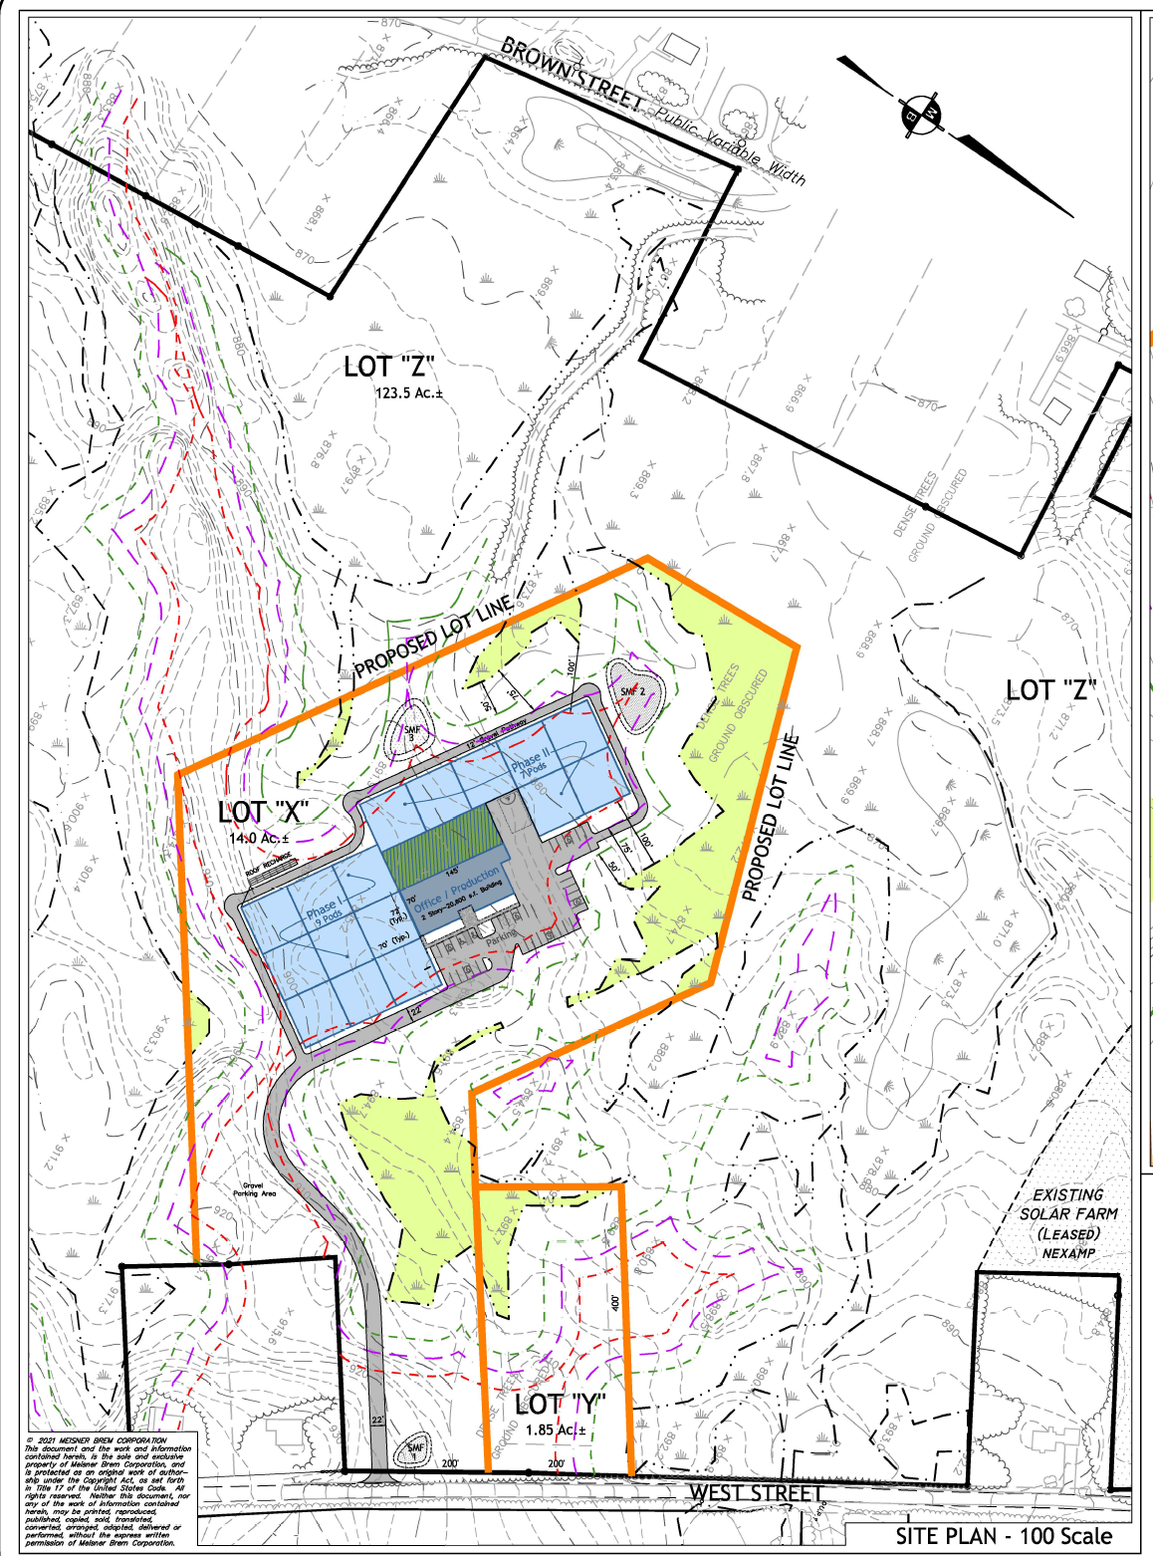
CNA Stores Vision for our Winchendon, MA Facility

Slide 9
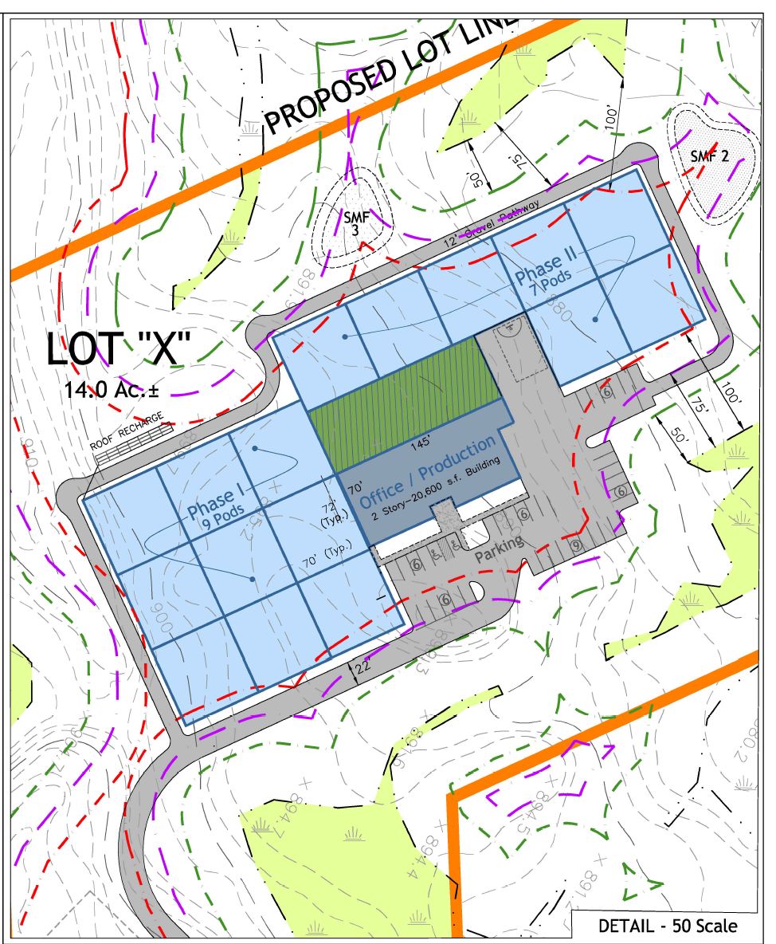
CNA Stores Vision for our Winchendon, MA Facility
CULTIVATION AND MANUFACTURING SITE
This project will be completed in phases
Phase 1
Office Area
9 Grow Rooms
Manufacturing Area
Phase 2
7 Additional Grow Rooms
Additional Manufacturing

Slide 10
CNA Stores Vision for our Winchendon, MA Facility
Vertical Farming
Water Cooled LED lights
Capture and reuse the condensate
Driven by automation and AI
Focused on Energy Efficiency
Solar power on site for our facility

Slide 11
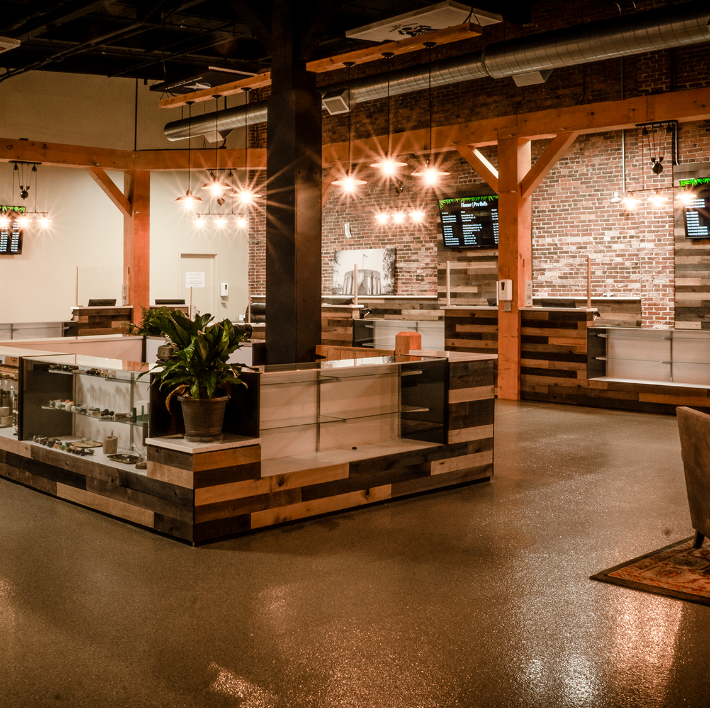
CNA Stores Physical Security Plan
Crime prevention through environmental design (CPTED)
Closed-Circuit Video Surveillance
Alarm Systems which will be monitored 24/7/365
Bio-Metric Electronic Access Control
Safe Transportation Procedures
Minimal Signage
Seed-To-Sale software to limit diversion to minors

Slide 12
Positive Community Impact
Gross Wholesale Contributions in the amount of 3 percent (potential to exceed $1 million)
$25,000 worth of Donations to local charities.
100 Community Volunteer Hours
Local Vendor Participation
Employment opportunities for the citizens of Winchendon
Operational hours monitored by security officer
Creating jobs for Veterans and locals
U.S. Veteran-Led Company

Slide 13
The Team

Slide 14
CNA Stores Team
Robert DiFazio, Chief Executive Officer
Billie Haggard, Co-Founder
Michele Whitley, Chief Operations Officer
Dan Magoon, Director of Security

Slide 15
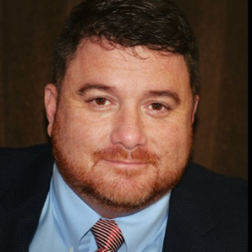
Executive Team
Chief Executive Officer Robert DiFazio
Robert DiFazio, a service-disabled veteran, started his career in the United States Navy Nuclear Power Program and has spent the last 24 years working in mission critical environments and developing small businesses. As a 17-year resident of Amesbury, Mr. DiFazio successfully built two companies: Critical Solutions Group and Critical Power Testing and Maintenance. Mr. DiFazio developed and implemented Data Center solutions to some of the nation’s largest Data Center and technology companies including Microsoft, Facebook, Google, TD Bank Financial Group, Fannie Mae, Time Warner Cable, Tesla and many others.
For 13 years Mr. DiFazio was Chief Executive Officer and founder of Critical Solutions Group, a Service-Disabled Veteran Owned Small Business. Critical Solutions Groups data center services include commissioning, design support, construction project management and load bank services. Mr. DiFazio’s diverse experience in design, operation and management of data centers enables him to cover every phase of a data center through its life-cycle, from operations and maintenance, to remote management, energy audits, project management and facilities infrastructure training. Mr. DiFazio was responsible for developing and implementing the vision and the strategy of this business until it was acquired by BGIS, a Brookfield Asset Management Company.

Slide 16
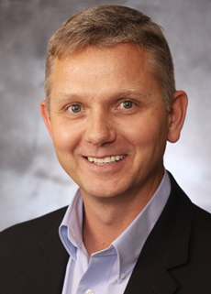
Executive Team
Co-Founder Billie Haggard
Billie is an experienced leader and an expert in developing and executing strategic business initiatives while leading high-performance operational groups. Prior to coming to CNA Stores Billie was Senior Vice President of Operations for Aligned Data Centers, Billie was responsible for spearheading the company’s data center performance optimization. He managed mission critical operations and on-site personnel, anticipated market direction to keep the company’s facilities up-to-date, negotiated and managed vendor relationships, ensured operational and professional excellence and more.
Billie also served as Operations Director for a global leader in facility and asset management, where he was responsible for all aspects of management, operations, maintenance and training for over 3 million square feet of data center space and 200 personnel. He has also served in leadership positions with Critical Solutions Group (CSG), Microsoft Data Center Delivery Group, Switch and Data and CoreSite Realty Corporation, garnering deep insight into creating successful programs and various strategic planning initiatives to enhance corporate performance and ensure quality across the board. Billie began his career in the U.S. Navy as a Nuclear Machinist Mate. During this time he earned four Navy Achievement Medals as a result of his outstanding instruction and training abilities. He received a B.S. in Business Management and a Master’s Degree from Colorado State University.

Slide 17
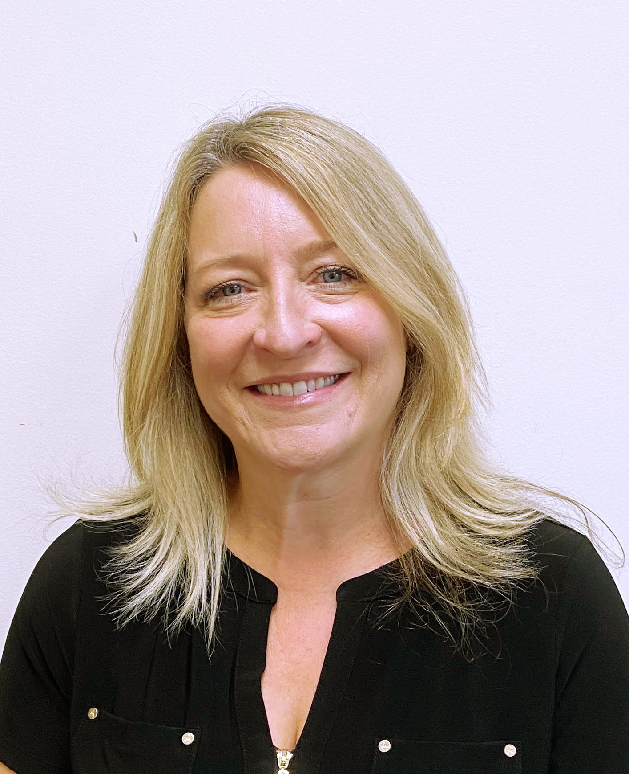
Executive Team
Chief Operations Officer Michele Whitley
Michele is an experienced leader and responsible for the day-to-day operations of the company and ensuring that all the systems, resources, and people are in place to achieve the goals of the company. She is responsible for developing our company culture and building employee alignment with company goals to meet the key targets of our organization.
Prior to joining CNA Stores Inc, Michele was the Practice Manager for 23 years at North Shore and Brookline Endodontics, a specialty dental practice with 6 offices in and north of Boston, MA. She led a team of over 40 employees and doctors. Her responsibilities ranged from contract negotiations, recruiting new employees and Doctors, managing the finances and day-to-day operations of the 6 locations. She set up and implemented systems to allow the practice to run more efficiently. She was also responsible for ensuring the practice was compliant with HIPAA regulations. During her time with NSBENDO, Michele was instrumental in growing the practice from four to six locations. Michele has presented courses for the American Association of Endodontics during their annual sessions, and at the University of California, San Francisco on running a multi-location, multi-doctor practice. Michele has a strong work ethic and has had much success in creating a culture that breeds teamwork and unity. Michele is a native of Niagara Falls, NY and an avid Buffalo Bills fan.

Slide 18
Executive Team
Director of Security Dan Magoon
Dan is a committed and driven community leader. As Director of Security, he is responsible for all aspects of the physical security, Video Management Systems, Access Control, and corporate compliance with the local and state regulating bodies. He plays a vital role in the development of the CNA Stores security policies and implementation of our security process to safeguard our customers and our employees.
Prior to joining the CNA Team, Dan was CEO of SBI Armor a company that specializes in protective services. Dan is a former U.S. Army Paratrooper with combat experience in Iraq and Afghanistan. He spent the last decade building a non-profit organization called Massachusetts Fallen Heroes. He is a founding member and the Executive Director. Before entering the Security Industry, he spent 11 Years as a Boston Firefighter. During his time at the BFD, he held leadership positions on the Executive Board at the Boston Firefighters Local Union 718 and currently serves as Chairman of the Board at the Boston Firefighters Credit Union.
He currently resides in Dorchester, Massachusetts with his wife Megan and two sons, Conrad and Winston.

Slide 19
www.cnastores.com
For Further information, please contact:
Robert DiFazio
781-589-3192
rob@cnastores.com

