Slide 1
How Winchendon addressed it’s financial challenges and paid off the deficit borrowing six years early
Presented by: Board Chair Audrey Labrie
Town Manager Keith Hickey

Slide 2
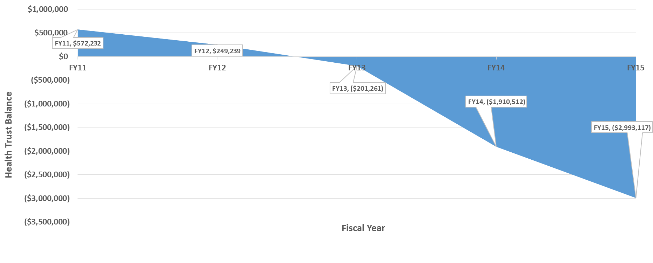
How did Winchendon get into Financial Difficulties
Winchendon found itself needing to borrow $3.5 million from the Commonwealth due primarily from a deficit in the Town’s health insurance trust fund.

Slide 3
Monthly Family Health Insurance Premiums
Town no longer
self insured
($201,261)

Slide 4
Enabling Deficit Legislation
AN ACT RELATIVE TO THE FINANCIAL CONDITION OF THE TOWN OF WINCHENDON (Approved January 6, 2014)
Be it enacted by the Senate and House of Representatives in General Court assembled, and by the authority of the same as follows:
SECTION 1. (a) Notwithstanding any general or special law, town charter provision or local by-law to the contrary, the town of Winchendon, with the approval of the director of accounts in the department of revenue may borrow sums, as approved by the board of selectmen and the director, to achieve a balanced budget for fiscal years 2015 and 2016; provided, however, that the aggregate of all such sums shall not exceed $5,700,000, unless the director of accounts makes a separate finding that an additional $300,000 is necessary for the town to achieve a balanced budget, in which case, the aggregate of all such sums shall not exceed $6,000,000.

Slide 5
Enabling Deficit Legislation
SECTION 5. (c) Establish and fund a supplemental reserve fund sum for fiscal year
2016 0.25% of the gross amount to be raised for the prior fiscal year
2017 .50% of the gross amount to be raised for the prior fiscal year
2018 - .75% of the gross amount to be raised for the prior fiscal year
2019 1% of the gross amount to be raised for the prior fiscal year
2020 and each subsequent fiscal year during which bonds, notes or an amortization amount authorized under this act remain outstanding shall be an amount equal to 1.5% of the gross amount to be raised for the prior fiscal year
The supplemental reserve balance is $323,776. The funds can be withdrawn from the reserve two years after the bond has been paid in full. In Winchendon’s case the date the reserve can be withdrawn is March 1, 2021. My current intention for those funds is to propose the funds be used to begin to address the Town’s OPEB liability.

Slide 6
Chronology of Transition
April 6, 2015 – Current Town Manager’s was bought out his employment contract.
May 4, 2015 - All five members of the sitting Board of Selectmen were recalled and replaced with five new Board members.
June 9, 2015 – Board of Selectmen hired Bernie Lynch as a part time Acting Town Manager.
December 14, 2015 – Keith Hickey began as Town Manager.

Slide 7
Interim Steps Taken by the Newly Elected Board of Selectmen
In 2015 the Board of Selectmen contracted with Bernie Lynch manage the community while a search was conducted for a new Town Manager. Bernie used his years of experience and professional relationships to begin addressing the financial challenges facing Winchendon. During his six months Mr. Lynch was able to move Winchendon’s health insurance to the GIC which brought rate stability and eliminated the past risk of unanticipated claims, developed a five year financial forecast, addressed the FY16 unbalanced budget by proposing significant budget cuts to the Town and School Department.
Bernie’s brought decades of knowledge enabling him to address the immediate needs of the community and set the table for the next Town Manager to be successful. I owe a great deal of gratitude to Bernie for initiating some substantial changes that has allowed Winchendon to achieve many of its financial successes.

Slide 8
A Little About me……
I have been in municipal government for 30 years, the last 19 as a Town Manager. Prior to becoming a Town Manager my background was in finance, serving as the Finance and Personnel Director for the Town of Bedford, New Hampshire.
Winchendon is the first community outside of New Hampshire I have worked for.

Slide 9
Challenges I Faced as the New Winchendon Town Manager
Maintain the momentum generated by Mr. Lynch.
Develop a balanced, accurate budget that best met the needs of the community in the upcoming fiscal year without leveraging future year budgets.
Prior budgets had relied on grant funds not yet approved to fund key departmental positions.
Budgets for school transportation, snow and ice and veteran’s services historically not funded at needed levels creating the need to transfer funds.
Find way to have municipal government more transparent. (Improved website, publish more information on the website, create Facebook page, local access TV)
Improve the relationship with the School Department.
Begin to reestablish the community’s trust in their government.

Slide 10
Changes Made During my Tenure
Instilled a “team” approach with senior management when addressing issues that impact town operations. Provided some autonomy to department heads to manage their departments.
Established a level of expectation of how staff would treat all of our customers.
Successfully implemented/addressed all 24 of the recommendations made in the July, 2015 Division of Local Services Financial Management Review.
Developed annual budgets that prioritized the needs of the community and properly funded necessary expenses.
Reviewed town fee schedule
Become more aggressive in addressing tax delinquencies. Funds for tax title attorney had been removed from the Tax Collector’s budget. Properties were not being brought to or being awarded to the Town by the Land Court.
Continue to explore opportunities to provide necessary municipal services in a more affordable way.
More aggressively seek out and apply for grant funds.

Slide 11
Examples of Grant Funds Awarded in the Past Three Years
Winchendon became a Green Community allowing the Town to be eligible to apply for grants to address energy improvements in Town buildings. The requirements to become a Green Community were started by the previous Town Manager. To date Winchendon has received $423,072 in Green Community grants which has funded furnace and window upgrades, improvements in HVAC systems and a variety of other energy improvements.
Grants have been awarded from the Small Bridge program, 911 grants for regionalizing emergency dispatch along with grant funds to upgrade streetlights to LED.
Winchendon was also awarded a $3.6 million dollar Complete Streets grant to reconstruct Central Street, our Main Street to include a total road reconstruction, new ADA complaint sidewalks and bike lanes. That project will commence in the summer of 2021.
Received a Community Compact Grant to update job descriptions and nonunion personnel policy.
A SAFER grant was awarded to fund the majority the cost of three new firefighters for three years.

Slide 12
Annual Free Cash 2011-2019

Slide 13
Impact of Paying the Debt Off Early
The deficit legislation required the town to use all Free Cash over the annual deficit bond payment to pay down the debt. Winchendon used $2.295 million of Free Cash to reduce the deficit balance.
Repaying the debt six years early saved over $106,000 in interest charges and allowed the funds previously appropriated for the debt payment to fund local budgetary needs.

Slide 14
Changes to the FY20 Budget With Deficit Bond Paid Off
The FY20 budget includes capital funds of $185,000. The FY17, 18 and 19 budget relied on Free Cash to purchase capital equipment.
Prior to that capital items such as a generator for the school and a new furnace for the Town Hall were funded by debt. Chapter 90 funds were used to purchase expensive DPW equipment rather than addressing road infrastructure needs.
Some positions lost during the FY16 budget cuts have been reestablished.
School funding has been provided in excess of net school spending allowing for funding of necessary staffing needs.

Slide 15
Policy Changes in the Enterprise Funds
Winchendon has three Enterprise Funds; Water, Sewer and Transfer Station.
Water and sewer bills were billed on a semiannual rather than the more typical basis until 2017. Moving to quarterly billing increased the number of transactions in the Collector’s Office but reduced the amount due to the end user, making it more affordable. In addition, moving to quarterly billing improved cash flow throughout the year.
Unpaid water and sewer bills were liened to the property connected to the water service rather than working with the utility user by implementing a payment plan or worst case scenario, shutting the water off to the property. In FY16 the uncollected water and sewer bills rose to $350,000 of what was committed annually. The Selectmen adopted a water shutoff policy that is weighed to working out a reasonable way to address the past due bill and not interrupting their water service. The uncollected balance at the end of FY18 was $25,000.

Slide 16
Policy Changes in the Enterprise Funds
The Transfer Station has been an Enterprise Fund since replacing the landfill in 1995. Many of those years the fund ran in a deficit.
Working with the newly appointed Director of Public Works changes were proposed to and approved by the Selectmen. While some of the changes proposed were more controversial than others, all of the changes made good business sense. Some of those changes included:
Reducing the hours the Transfer Station is open.
Amend the fee schedule to the cost incurred when disposing of demolition material, white goods, televisions etc.
Allowed residents from the neighboring community of Templeton to use the facility to increase revenue from trash bag sales and other disposable items.

Slide 17
Final Comments
In closing, any success Winchendon has achieved is due to a supportive Board of Selectmen, a strong, committed group of department heads, dedicated employees and a resilient group of property owners.
Lastly, I would like to thank the Supervisor of the Springfield Bureau of Account Supervisor Deb Wagner and Director of Accounts Mary Jane Handy for all of their guidance and support. When I first arrived in Winchendon I called often seeking advise and you always took my call.

