Slide 1
Town of Winchendon
FY 2023 Water and Wastewater Rate Study
March 14, 2022

Slide 2
Agenda
Introduction to Raftelis
Rate study overview
Financial plans and required rate increases
Alternative rate structure considerations
Customer impacts
WWTP Operations: cost/benefit

Slide 3
Who is
Raftelis?
Our staff includes
130+
consultants focused on finance/management/ communication/technology for the public sector
5 20
The largest utility financial and management consulting practice in the nation.
AWWA and WEF utility finance and management committees and subcommittees
&
chairs
members of
&
the Immediate Past President of AWWA
+
former utility leaders & subject matter experts in key fields like communications & data analytics

Slide 4
Rate Study
Overview

Slide 5
Rate Study Process
STEP 5: ASSESS EFFECTIVENESS IN ADDRESSING PRICING OBJECTIVES
STEP 4: DESIGN RATE STRUCTURE STEP 3: ALLOCATE COSTS
STEP 2: IDENTIFY REVENUE REQUIREMENTS & DEMAND PROJECTIONS
STEP 1: IDENTIFY FINANCIAL & PRICING OBJECTIVES
5
4
3
2
1

Slide 6
Revenue Requirements & Financial Planning
FINANCIAL PLAN ELEMENTS
CAPITAL PROJECT FUNDING
FINANCIAL PLAN INPUTS
Customer accounts
Billed consumption
Revenues
Operating expenses
Capital plan
Beginning cash position
Funding Mix
(Cash vs. Debt)
Debt
Covenants
ANNUAL REVENUE REQUIREMENTS
ANNUAL CASH FLOW
FISCAL POLICIES AND TARGETS
Cash
Reserves
Debt Service
Coverage

Slide 7
Financial Plans
& Required Rate Increases

Slide 8
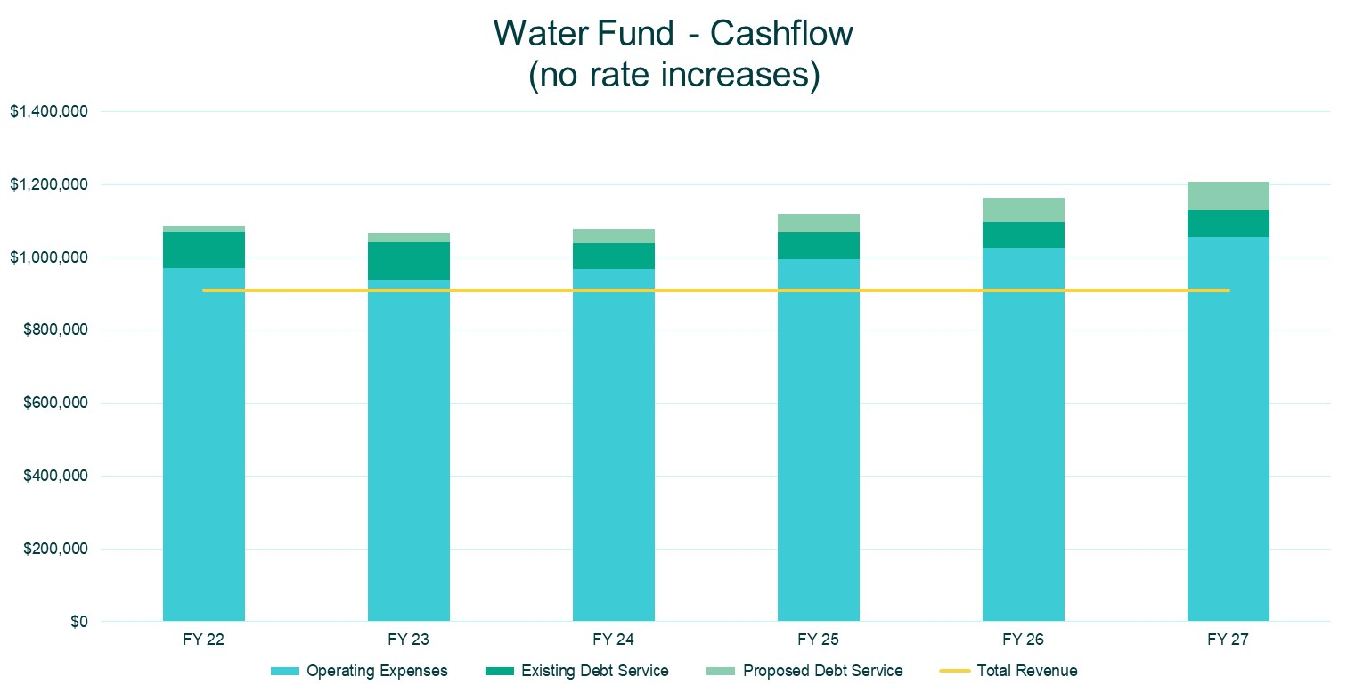

Slide 9
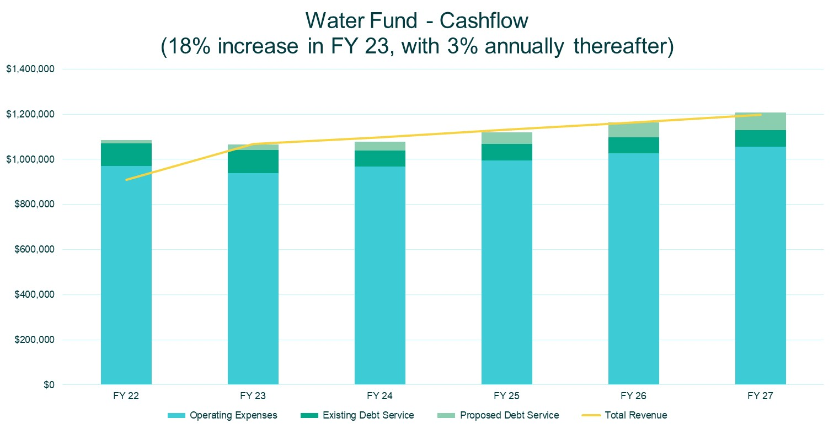

Slide 10
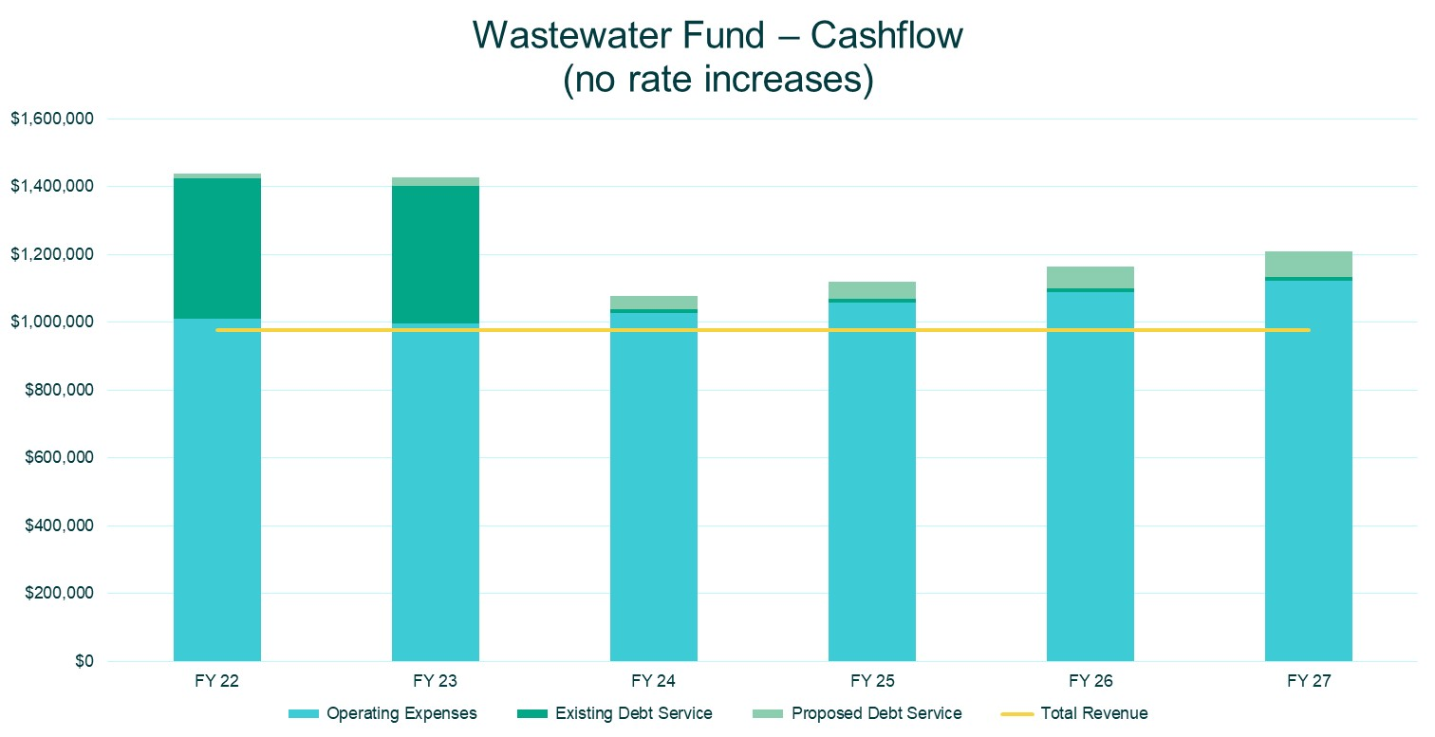

Slide 11
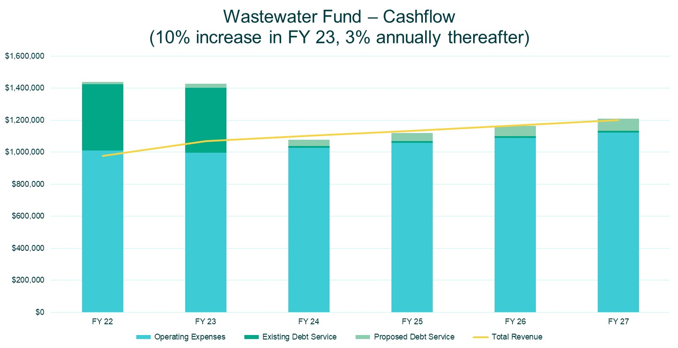

Slide 12
Alternative Rate
Structure Consideration

Slide 13
Alternative Rate Structure Consideration
The water and wastewater funds utilize a uniform volumetric rate, with no fixed component
Alternative structure components
Fixed charge by meter size for both water and wastewater
Two tier inclining block volumetric rates for single-family residential customers, while maintaining a uniform volumetric rate for non-single-family residential customers (water rates only)
Maintain uniform volumetric rates for all sewer customers

Slide 14
Water Rate Comparison
Volumetric Rates (per Ccf) | FY 2023 Proposed Existing Rate Structure | FY 2023 Proposed Alternative Rate Structure
SFR Tier 1 (0-18 Ccf) | $7.09 | $4.90
SFR Tier 2 (> 18 Ccf) | $7.09 | $5.39
Multi-Family Residential | $7.09 | $6.13
Non-Residential | $7.09 | $6.13
Fixed Charge (per quarter) | FY 2023 Proposed Existing Rate Structure | FY 2023 Proposed Alternative Rate Structure
5/8” | $- | $20.00
¾” | $- | $25.00
1” | $- | $30.00
1.25” | $- | $30.00
1.5” | $- | $30.00
2” | $- | $40.00
3” | $- | $70.00
4” | $- | $115.00
6” | $- | $135.00

Slide 15
Wastewater Rate Comparison
Volumetric Rates (per Ccf) | FY 2023 Proposed Existing Rate Structure | FY 2023 Proposed Alternative Rate Structure
SFR Tier 1 (0-18 Ccf) | $11.54 | $9.81
SFR Tier 2 (> 18 Ccf) | $11.54 | $9.81
Multi-Family Residential | $11.54 | $9.81
Non-Residential | $11.54 | $9.81
Fixed Charge (per quarter) | FY 2023 Proposed Existing Rate Structure | FY 2023 Proposed Alternative Rate Structure
5/8” | $- | $20.00
¾” | $- | $25.00
1” | $- | $30.00
1.25” | $- | $30.00
1.5” | $- | $30.00
2” | $- | $40.00
3” | $- | $70.00
4” | $- | $115.00
6” | $- | $135.00

Slide 16
Customer Impacts

Slide 17
Highlights
Maintaining the existing rate structures, a single-family residential customer using 15 Ccf per quarter will experience a 13% increase in their combined bill. If rates are restructured, that increase would only be 5%
Conversely, a non-residential customer using 80 Ccf per quarter will experience 13% and 17% increases, under existing and restructured rates, respectively
A multi-family residential customer using 30 Ccf per quarter will experience an approximately 13% increase regardless of rate structure

Slide 18
Wastewater Treatment Plant Operations – Cost/Benefit Analysis
There is little cost difference between contract and in-house operations
Contracting operations mitigates the Town’s risk exposure and limits potential unexpected costs
The hiring market for operations staff within the industry is dismal
Quality candidates are few and far between and are demanding significantly higher salaries than prior market norms
At this time, it is recommended to continue contract operations

Slide 19
Conclusions
Water user charge revenues need to increase by 18% for FY 2023
Wastewater user charge revenues need to increase by 10% for FY 2023
Rate structural changes will:
Reduce impacts on typical single-family-residential (SFR) customers
Create a larger impact for some non-residential customers
Enhance both funds’ revenue stability through fixed charges
Incentivize the efficient use of the Town’s resources from SFR customers
Require modifications to billing operations
Maintaining wastewater treatment contract operations is recommended at this time

Slide 20
Raftelis is a Registered Municipal Advisor within the meaning as defined in Section 15B (e) of the Securities Exchange Act of 1934 and the rules and regulations promulgated thereunder (Municipal Advisor Rule). However, except in circumstances where Raftelis expressly agrees otherwise in writing, Raftelis is not acting as a Municipal Advisor, and the opinions or views contained herein are not intended to be, and do not constitute “advice” within the meaning of the Municipal Advisor Rule.

Slide 21
Thank you!
Contact: Dave Fox
774 243 0619 / dfox@raftelis.com

